Slide 1
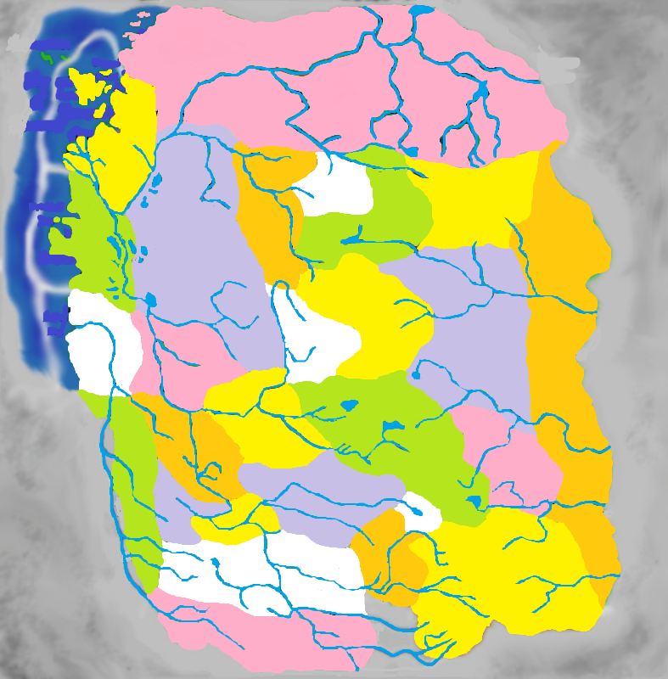
Notes:
735: The Core. This presentation attempts to represent the way Ravenloft was formed on the presumption that Barovia appeared first and every domain that followed attached itself to Barovia. This is the Canon understanding of formation, with as few added assumptions as possible. In each slide of this presentation and the alternate projects, take a moment to look at the world as it existed. Who did the people trade with? Where were the major threats? How would you run a campaign set in this time period? The answers to these questions can help color the Ravenloft world.

Slide 2
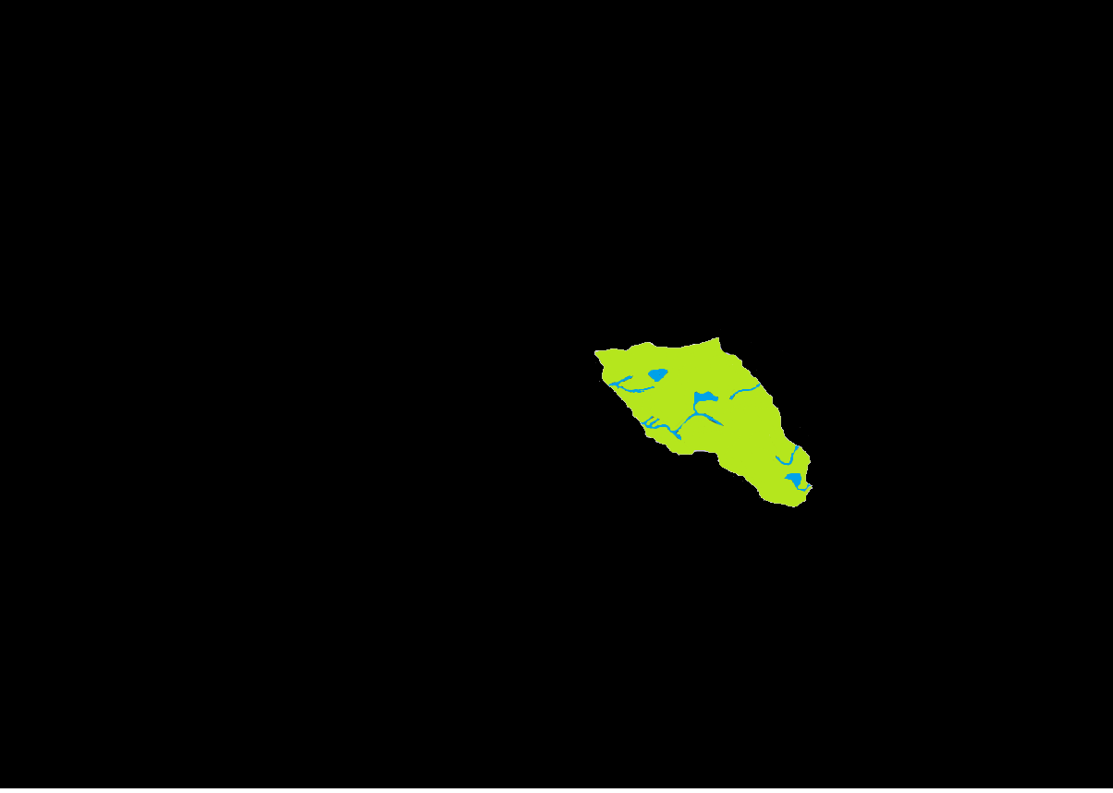
351 BC: Barovia Appears
Notes:
351 BC: Barovia is drawn into the Demiplane of Dread following the horrific events at Castle Ravenloft on the day of Sergei and Tatyana’s wedding. Barovia would remain isolated in this fashion for 196 years, which goes a long way to coloring the Barovian populace’s xenophobia. Several powerful characters enter the demiplane during this period, particularly the Vistani, Jander Sunstar and Azalin.

Slide 3
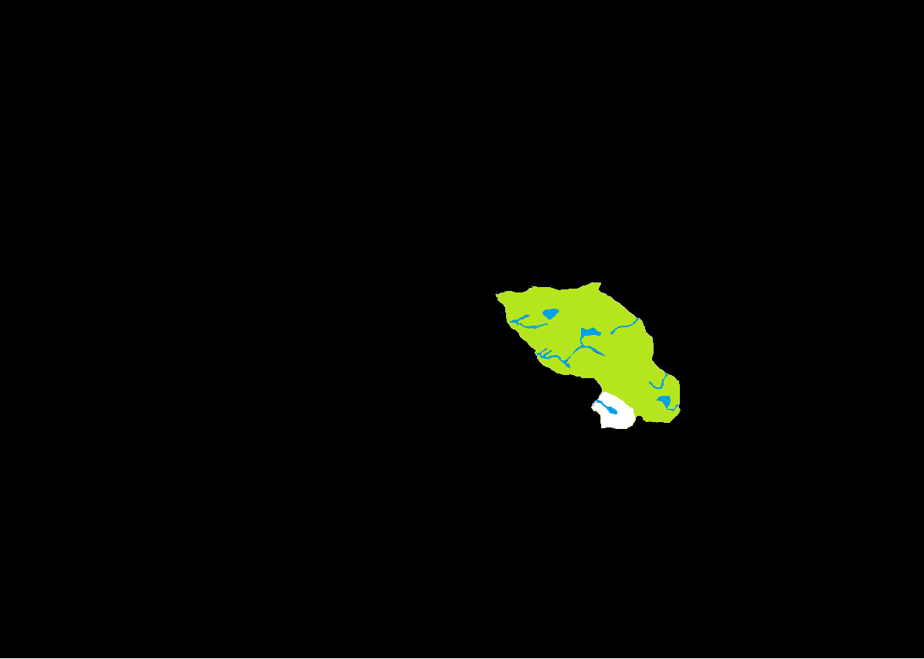
547 BC: Forlorn Appears
Notes:
547 BC: Forlorn appears on Barovia’s Southern wilderness, drawn from an un-named world. It is inhospitable and has a very small human population of its own, and thus contributes little in the way of economic or diplomatic variety to Barovia. It is 28 years before the next domain joins the Core, however other islands are formed in the Mists during this time, particularly Har-Akir, Zherisia, Sebua & Kalidnay.

Slide 4

575 BC: Arak Appears
Notes:
575 BC: When Arak appeared on Barovia’s border it had at least a token human populace on its surface, known as the Arakites. Arak is an interesting case in that it was created as a direct result of the Shadow Fey’s betrayal of their lord, Gwydion. Whether Arak himself knew that the destination of his escape was the Demiplane of Dread is unknown, though if he was aware then Gwydion’s yoke must have rested quite heavily if the Land of Mists could be considered preferable. It can be assumed that the Temporal Fugue is in place beneath the surface from the domain’s inception.

Slide 5
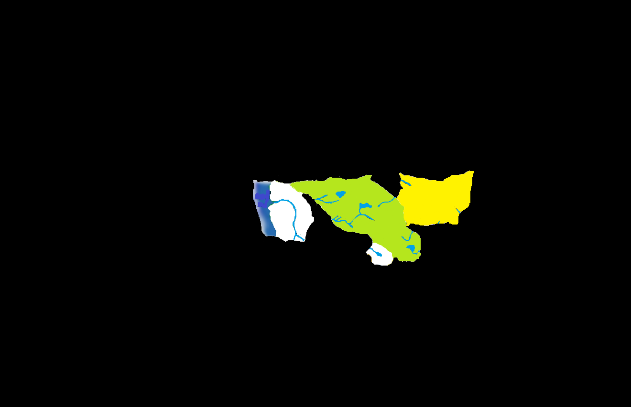
579 BC (Autumn): Mordent Drawn In
Notes:
579 BC (Autumn): After exploring Arak, Azalin devised a new plan to escape the demiplane, which instead brought more land toward the Land of Mists. Both Azalin and Strahd have little to no recollection of the events that occurred during their ritual, but the failure appears to have been the last straw for the lich and he abandoned Barovia thinking he could have better success on his own. Mordent itself fell under the rulership of Wilfred Godefroy.

Slide 6
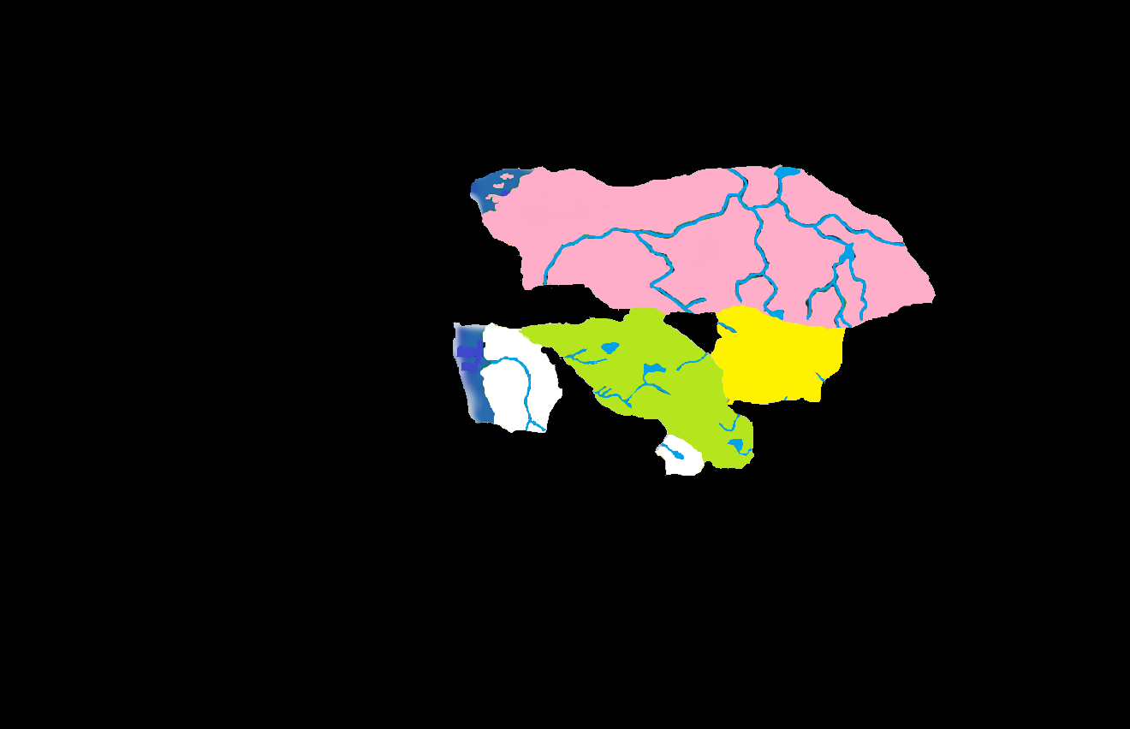
579 BC (Winter): Darkon Appears
Notes:
579 BC (Winter): Azalin didn’t realize the folly of his hubris until it was too late. As he left Barovia for the last time his own prison sprawled before him, the mammoth domain of Darkon. It is said that the current city of Martira Bay was just a small village at this time. After consolidating power, Azalin enacted a short war against Barovia, which amounted to little more than a few border skirmishes. Economically and Diplomatically, Darkon was self sufficient. The people of Mordent also managed to get most of what they needed from the sea, and had no reason for extended contact with the rest of the Core.

Slide 7
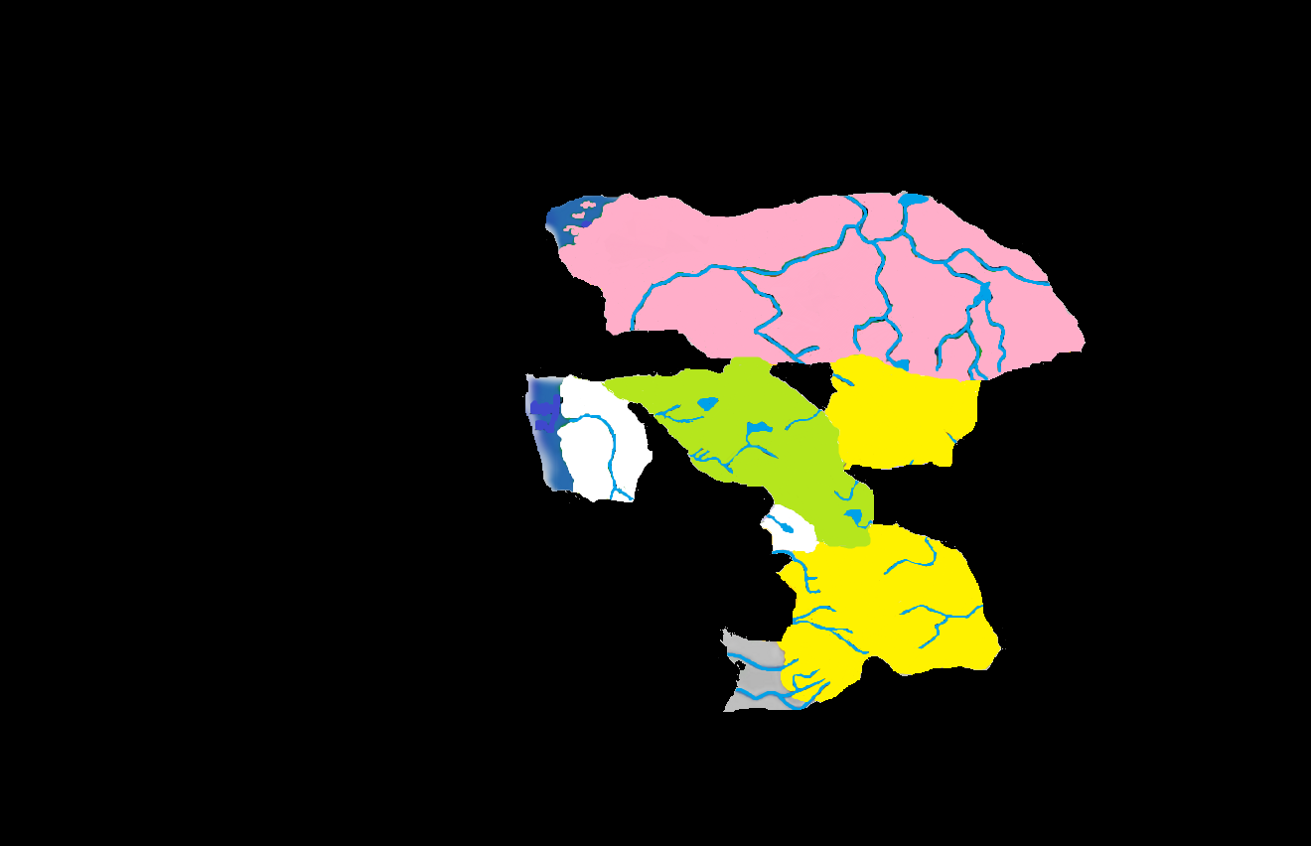
581 BC: Bluetspur Spawned
Notes:
581 BC: In every published timeline, this event is always described the same: “Illithids spawn Bluetspur.” I have taken this to mean that the vile mind flayers created this domain on purpose, as part of some nefarious plan to harvest brains. They obviously had some sort of human population, possibly as slaves, because villages in southern Barovia began receiving refugees from the new land. They called themselves the “Thaan” and were found to have amazing psionic powers. It is presumed the Illithids numbered in the very least in the hundreds, and how they did not overrun everything south of Darkon is a mystery to this day .

Slide 8
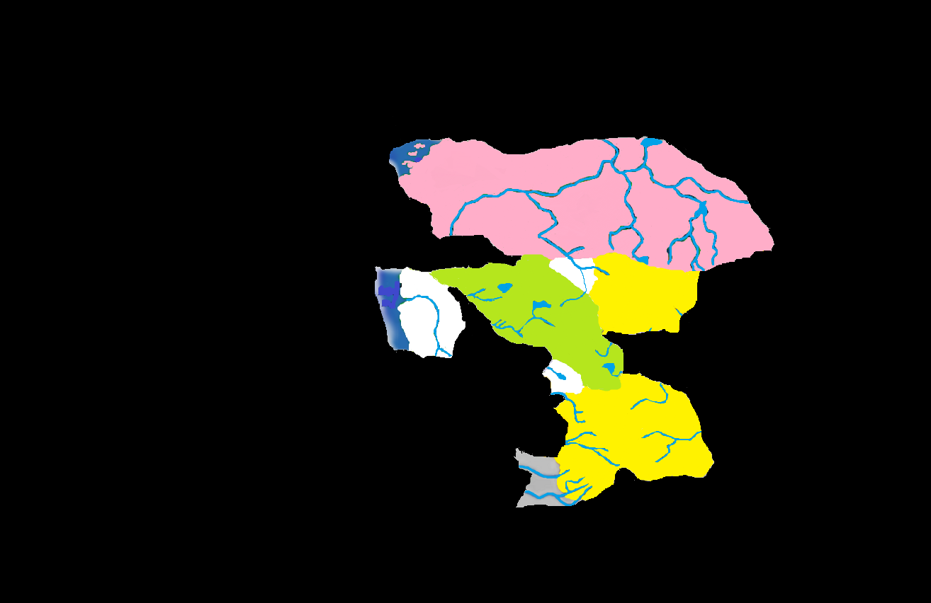
588 BC: Keening Appears
Notes:
588 BC: Drow Elves had taken up residence beneath the surface of Arak as early as 577 BC, bringing with them the worship of their dark goddess. After a brief power struggle, the head priestess and her child were sentenced to death by the rays of the sun. When the sun hit the doomed pair, their shrieks were so terrible that all surface life was wiped from the surface of Arak and afterwards the small domain of Keening had formed around Mt. Lament.

Slide 9
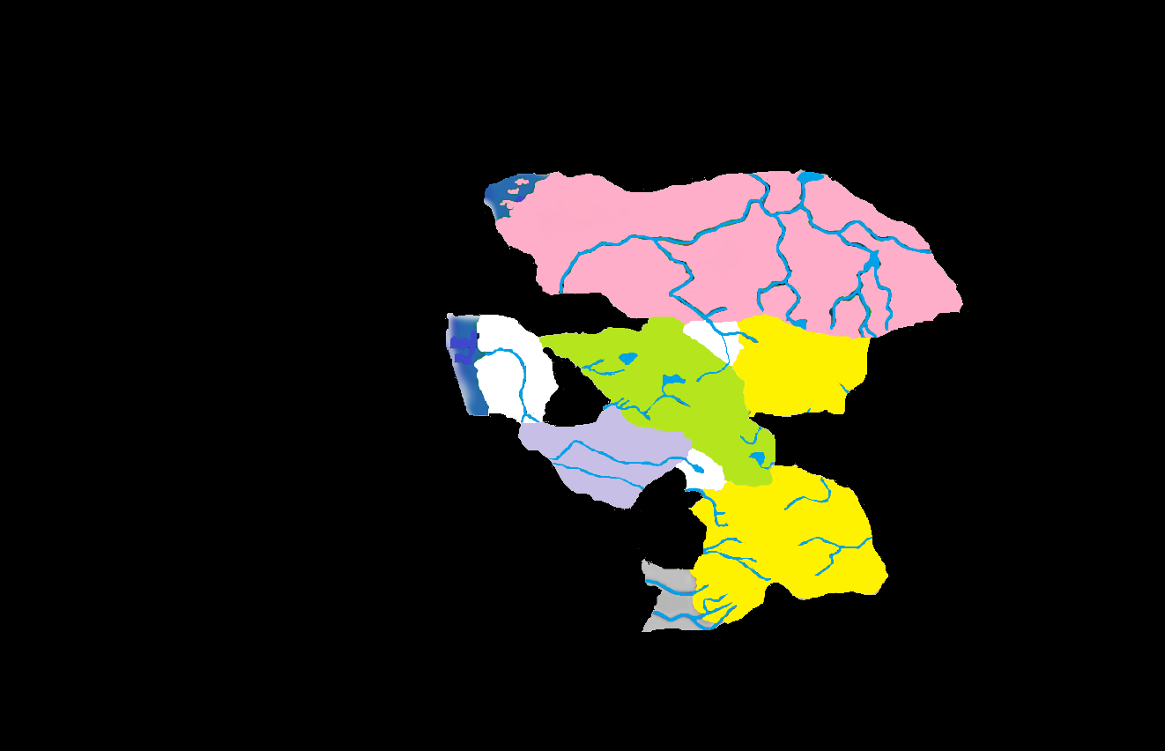
593 BC: Gundarak Forms
Notes:
593 BC: The vicious vampire, Duke Gundar, was drawn from an un-named world and granted the domain of Gundarak. As they were both soldiers in life, and both strong willed, it could be supposed that conflict initially erupted between Gundar and Strahd, though probably not a full-scale war. The Gundarakites most likely settled into normal trade and attempts to exploit resources in nearby domains like Forlorn. It is known that the island domain of Pharazia also formed during this time period, in the year 590 BC.

Slide 10
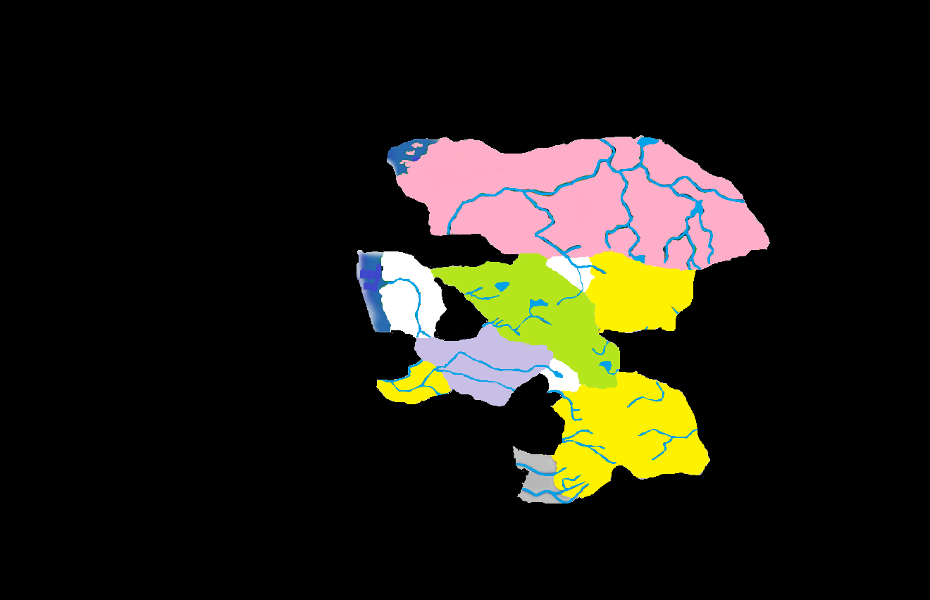
603 BC: Invidia Takes Shape
Notes:
603 BC: The werewolf Bakholis was granted the domain of Invidia, which formed at the confluence of the Gundar and Nharov Rivers, out of Gundarak. Earlier, in 600, the island domain of Vechor formed. Vechor will be reachable from the Core by sea after the Grand Conjunction, but since its geographical position cannot be mapped at this time, it has been omitted from this timeline. Also, in 611, the fiend Ebonbane became trapped in the Demiplane, in the island domain of Shadowborn Manor.

Slide 11
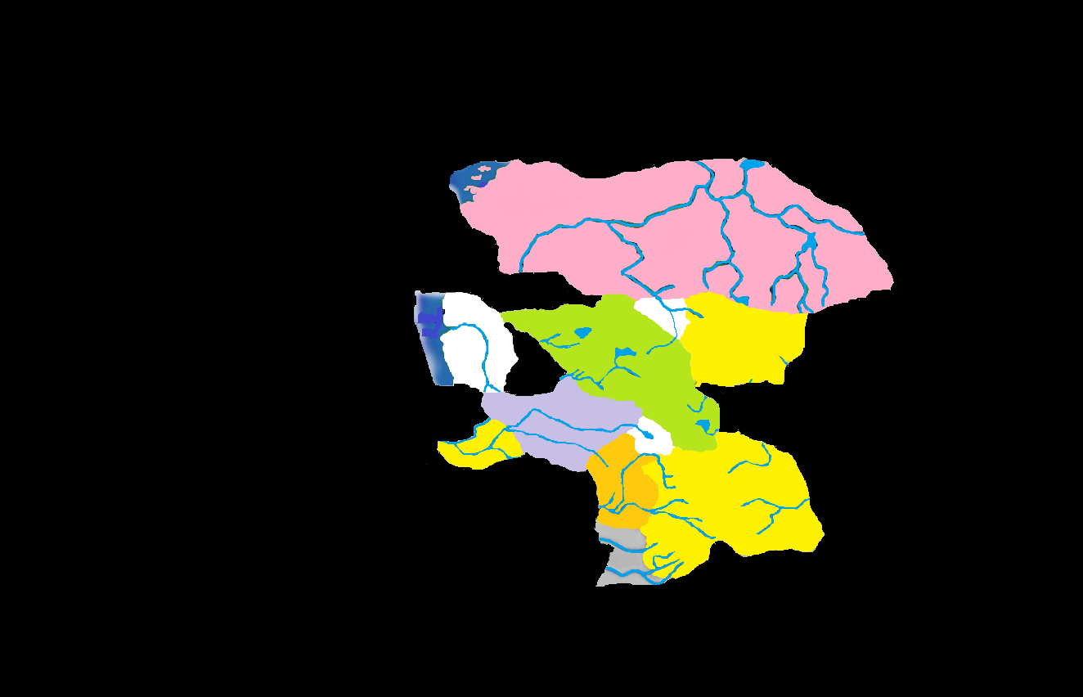
613 BC: Kartakass Appears
Notes:
613 BC: Although Harkon Lukas had been in Barovia since 610, his forested domain of Kartakass did not appear until 613. The human population of Kartakass was small but industrious. Rather than attempting to tame the forests that surrounded their villages, they chose to live at one with them, careful not to temp the vengeful spirits that protected the woods. Two years after Kartakass appeared, the island of Nidala formed, although it is unclear if it immediately joined the Shadowborn Cluster. Also, in 620, the domain of Timor was formed, although it is again difficult to determine if it was beneath the city of Paridon or some other doomed settlement.

Slide 12
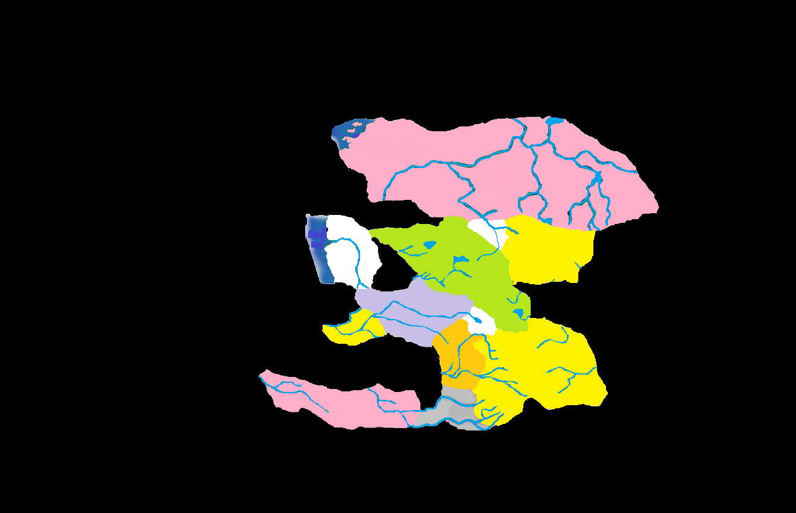
625 BC: Valachan Takes Shape
Notes:
625 BC: Baron Urik von Karkhov had been in Darkon for some time, as the vampiric slave of a Kargat member. Upon the death of his sire, he fled into the Mists and Valachan was formed. While technically a part of The Core, Valachan was difficult to reach and therefore remained isolated for about a century, it’s only navigable connection being the mist-bound Musarde River which led only to inhospitable Bluetspur. The population of Valachan therefore remained quite homogeneous and is markedly different from other humans in The Core.

Slide 13
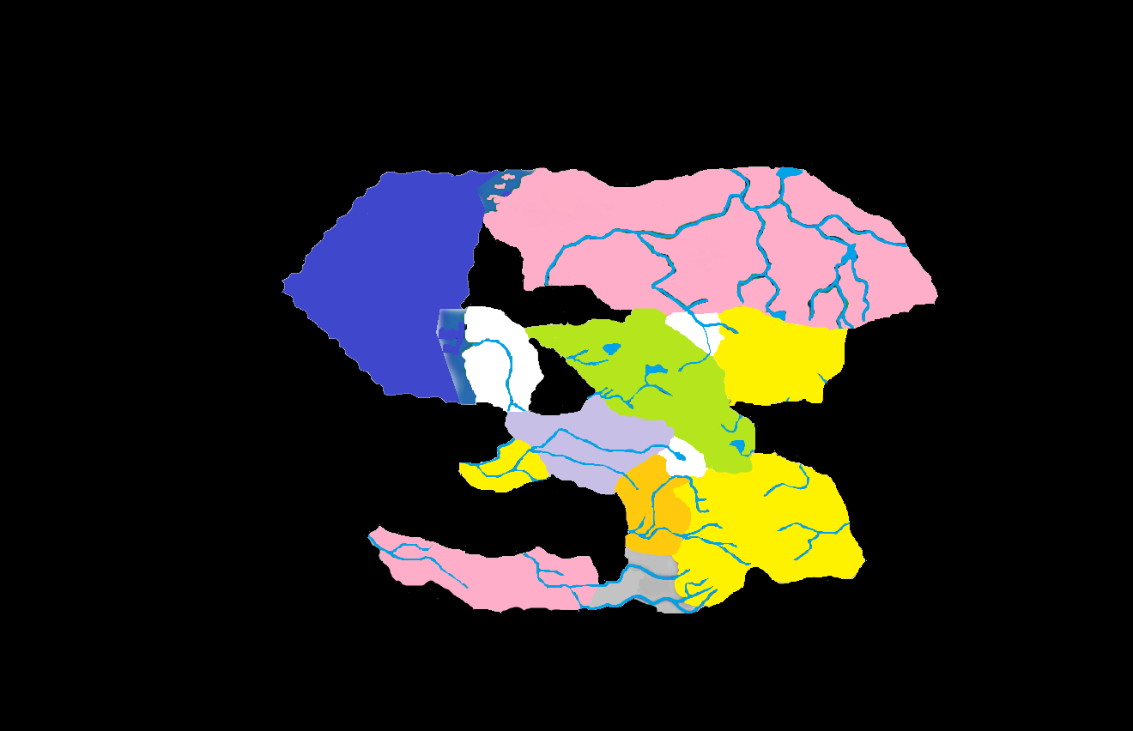
630 BC: Sea of Sorrows Unveiled
Notes:
630 BC: Though the gloomy seas had existed off the coasts of Mordent and Darkon since their formation, it was not until 630 that the Mists parted (slightly) to reveal a body of water that could finally be effectively navigated. Though no one would consider the cold, choppy water to be safe, it was considerably less risky than sailing into the Mists hoping to reach the right destination. The Sea of Sorrows has no definable borders, and to this day has not been effectively mapped. Also in 630, the tiny island of Staunton Bluffs was formed.

Slide 14
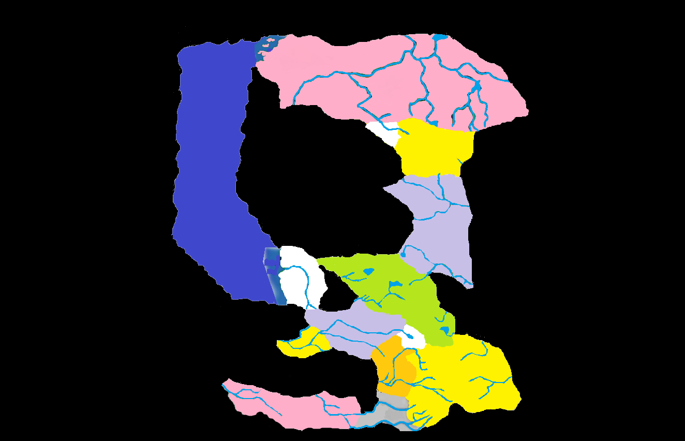
682 BC: Nova Vaasa Appears
Notes:
682 BC: One of the more dramatic appearances occurred in 682 when Nova Vaasa erupted from the Mists, violently separating the northern and southern Core. The Ivlis River now emptied into the newly revealed domain instead of Keening. The Vaasi people were members of a strict feudal society, and their superior horses were soon in demand across the Core. Two islands appeared in the relatively quiet four decades that preceded Nova Vaasa’s appearance. Souragne and Graben were mist-locked, although experienced captains were often able to reach them from the Sea of Sorrows.

Slide 15
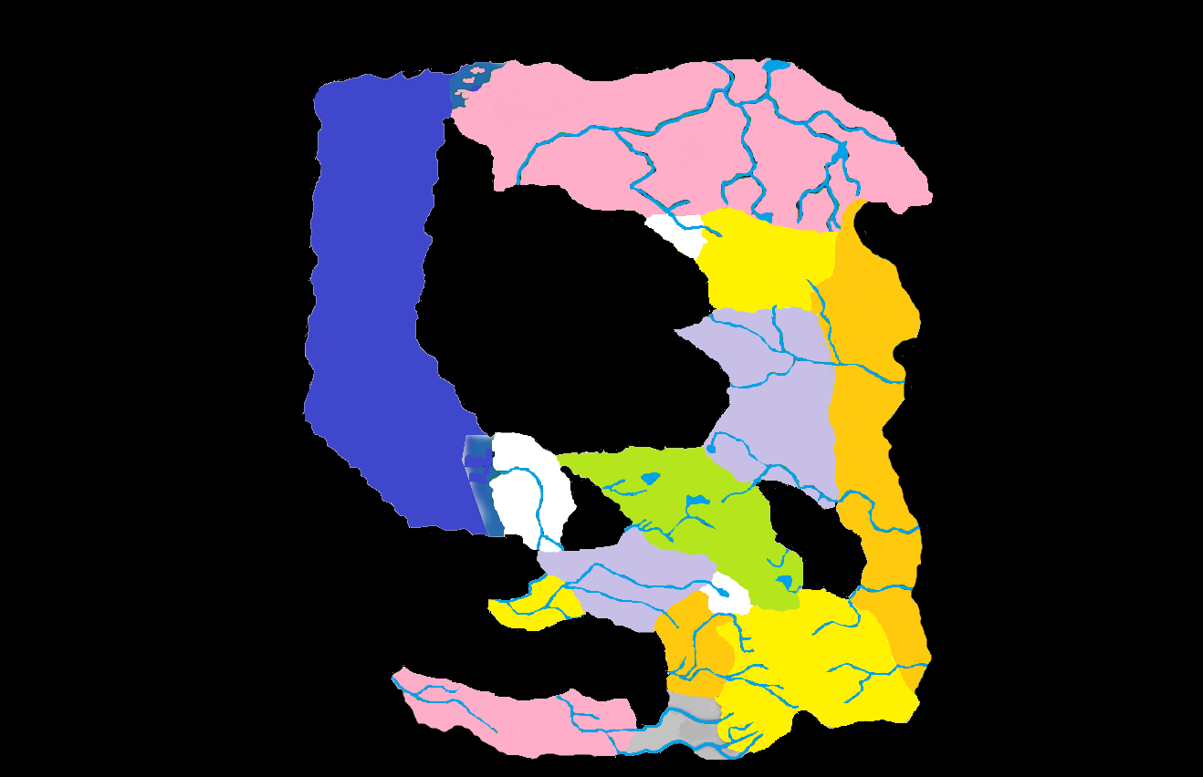
683 BC: The Nightmare Lands Appear
Notes:
683: While the Vaasi were great warriors, they had little time to think about conquest before the strange land known as the Nightmare Lands appeared on their eastern border. The Vaasi soldiers huddled near their castles, the prayers to their strange god unable to stop the strange beings--some disturbingly human--that stumbled across the frontier. Across the Core, the Vaasi took the blame for the appearance of the weird realm, and they were universally shunned. The expansionist nature of their religion also did little to endear them to their neighbors over the course of the next fifty years.

Slide 16
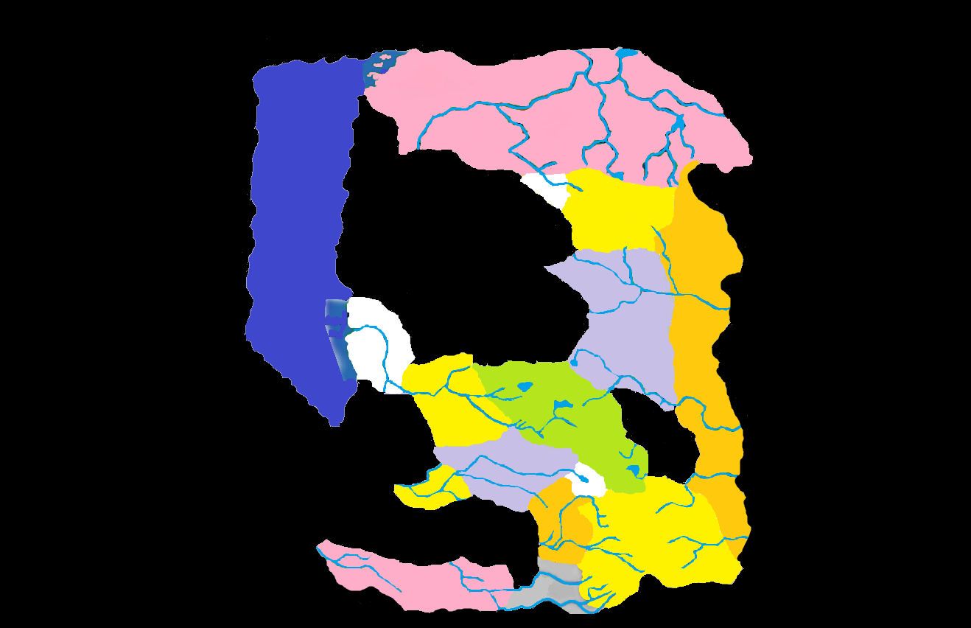
684 BC: Borca Appears
Notes:
684 BC: As the Core destabilized during the years of the Expanding Stain, Mordent was released from its thin connection to Barovia to make room for the newest domain: Borca. Not only was Borca drawn from the same world as Barovia, it was populated by the same people as Strahd’s homeland. Any nostalgia this could have roused in the vampire would have been quickly quenched when he learned that his hated enemies the Dilisnya had come with Borca to torment him further. The Borcans were an industrious and mercantile folk who immediately set about putting down trade routes with their neighbors.

Slide 17
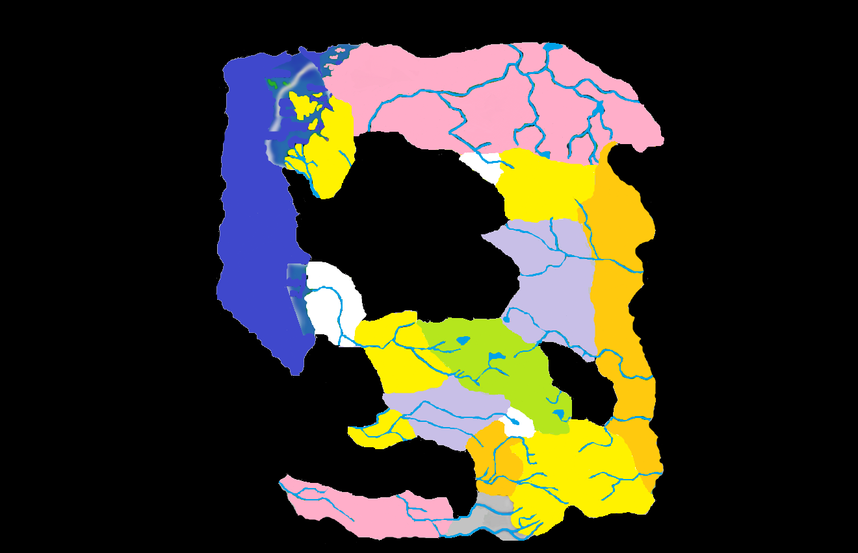
685 BC: Lamordia Appears
Notes:
685 BC: Sometimes overlooked by historians, Lamordia was formed in 685. The Lamordians were far more advanced and scientific than their neighbors, and though few in number they quickly gained a reputation as smiths and surgeons. Positioned in the middle of what had become a lively trade route between mordent and Martira Bay, some Lamordian technology spread quickly, while others found no audience among the superstitious residents in other realms. Although not technically part of Lamordia, the islands of The Finger all appeared at this time as well.

Slide 18
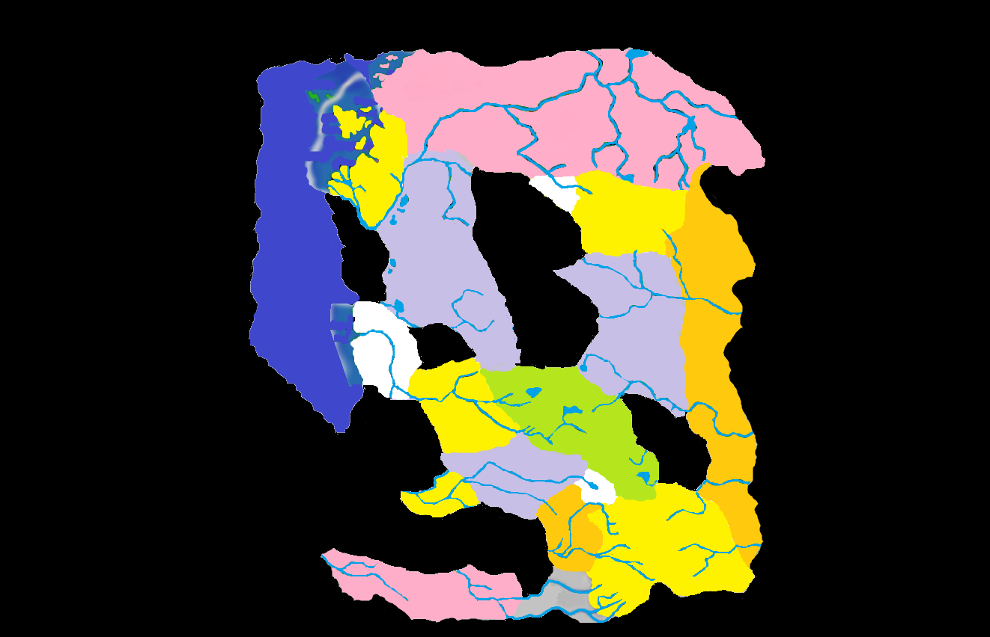
690 BC: Falkovnia Appears
Notes:
690 BC: The infamous Vlad Drakov had arrived in Darkon in 689, with a reign of terror around Nartok that older residents still speak of only in whispers. When Falkovnia appeared a year later, the unfamiliar sound of iron-shod soldiers began haunting every resident of the Core. The appearance of this hostile nation came with an ironic boon: Falkovnia was large and arable, and the abundance of grain allowed people in every corner of the Demiplane to begin eating better and actually led to a population boom in the decades to follow. Drakov took the gold gained from this sale to fund a number of unsuccessful and short-lived wars against his neighbors.

Slide 19
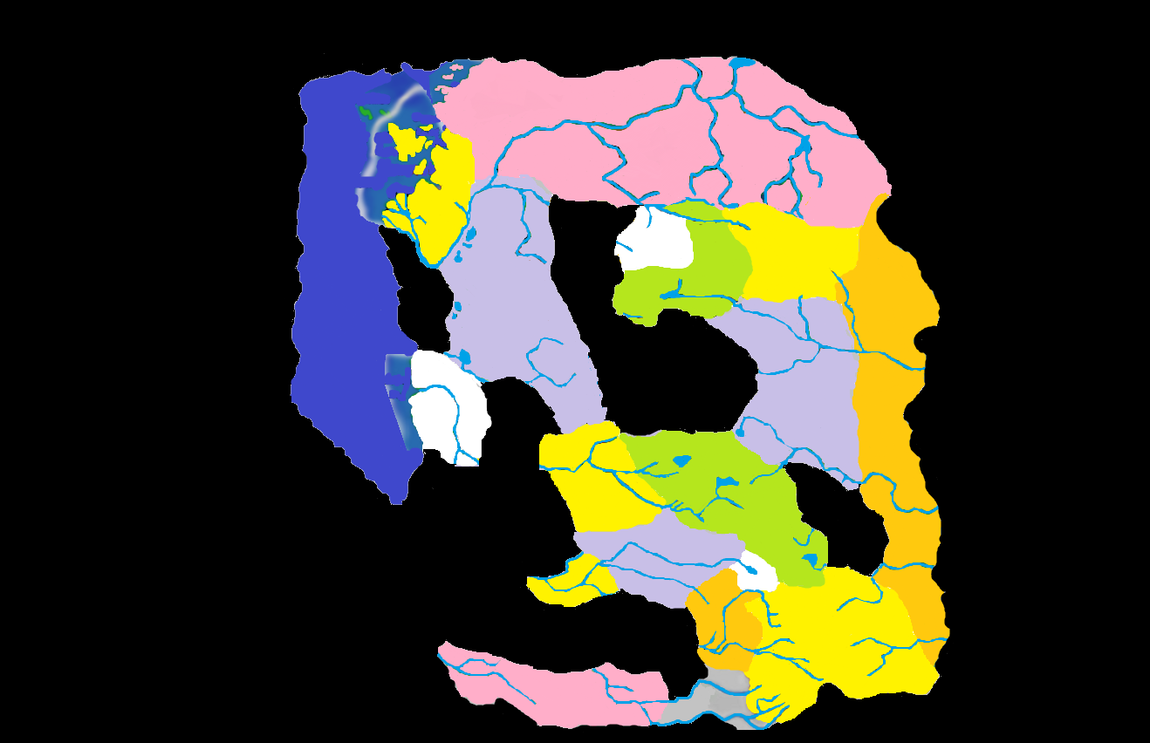
691 BC: Tepest Appears
Notes:
691 BC: The relatively unheralded appearance of the backwater domain that was Tepest was offset by the fact that its appearance stretched the Core further, isolating Mordent from what had been a friendly neighbor in Borca and dividing Arak from Keening. The Tepestani language was unlike any spoken by their neighbors and their religion resembled that of some savages living in the south. These circumstances isolated Tepest from its two strong neighbors for many years.

Slide 20
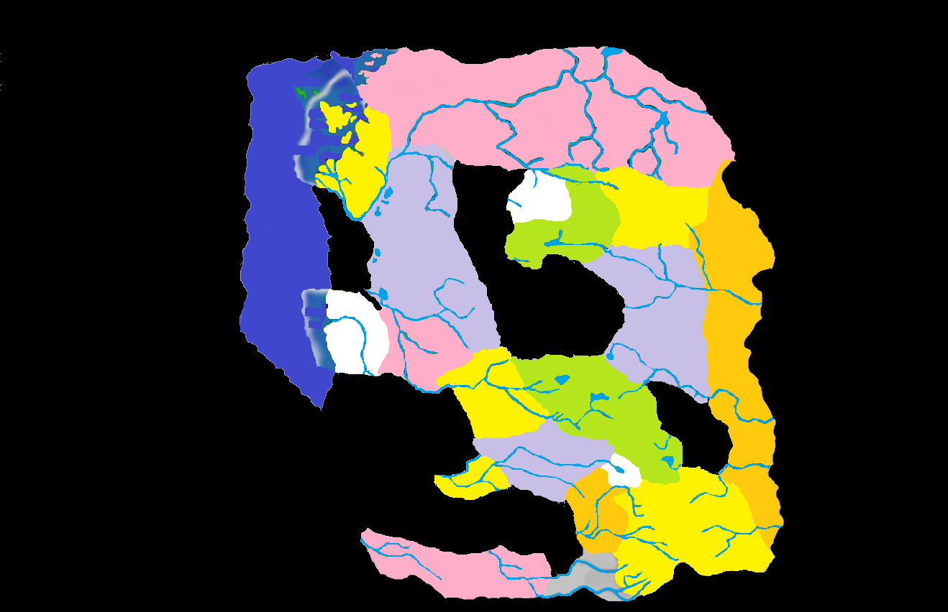
694 BC: Richemulot Appears
Notes:
694 BC: In addition to preparing to expand his borders, Drakov had domestic problems, namely a brazen group of brigands in the sewers of his cities. After almost four years of eluding the Talons, the Renier clan was finally chased from Falkovnia into the new domain of Richemulot. Mordent continued to drift further away from Barovia, although its border with Richemulot did have the advantage of removing Falkovnia from their doorstep. Mordent and Richemulot became fast allies, curiously bound by a common language. Richemulot became a haven for people looking to make a new start, later developing a reputation as a center for craftsmanship.

Slide 21
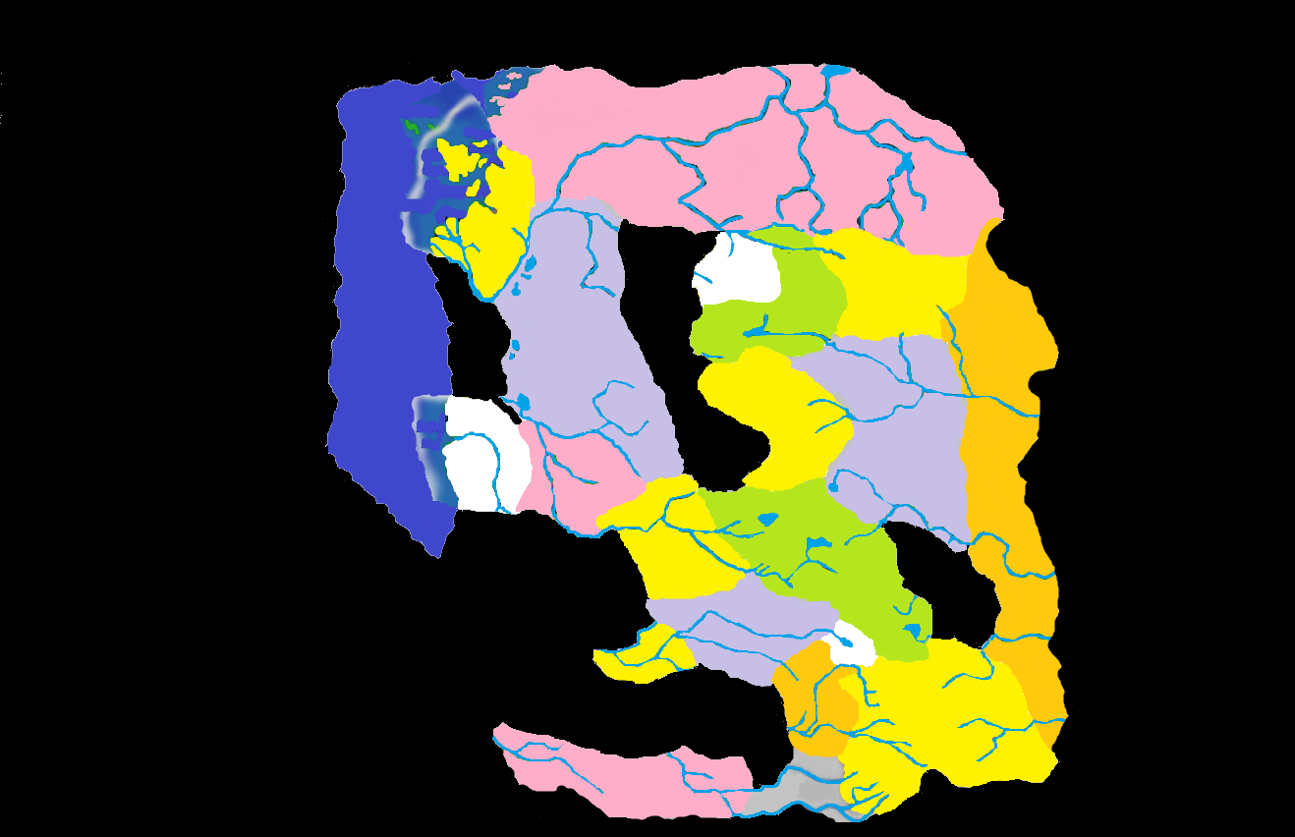
698 BC: Markovia Forms
Notes:
698 BC: After a gruesome series of murders in rural Barovia, the Mists spit forth a new spur of the imposing Balinok Mountains. Heavily forested, this realm came to be known as Markovia. Nova Vaasa attempted to claim the new area as their own, but the missionaries they sent into the desolate land were never heard from again. Those who spent time there and lived to tell about it reported odd beasts unlike any ever encountered in the Core before. Eventually, curiosity wore off and most people left the area alone.

Slide 22
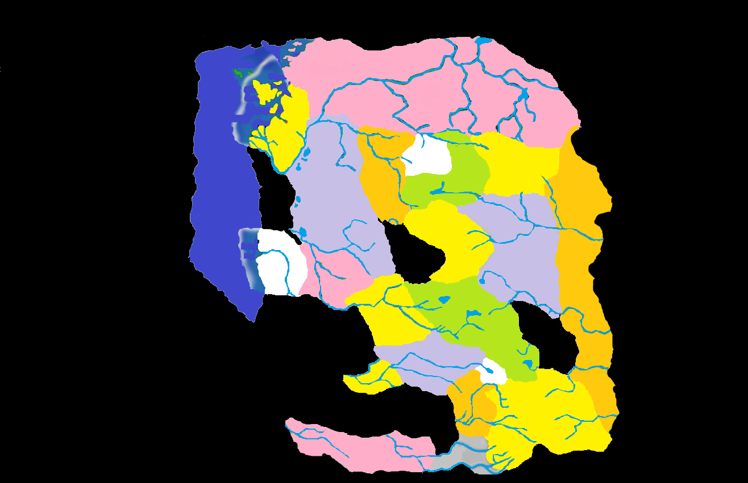
702 BC: G’Henna Appears
Notes:
702 BC: Azalin was initially irritated to notice the Balok-speaking nation on his border, but it soon became obvious that G’Henna was not a Barovian colony. Barovian holy man Yagno Petrovna had set up a theocracy to a strange god that demanded petitioners starve themselves as a sign of their devotion. Falkovnia staged an unsuccessful invasion shortly after the domain appeared, and aside from religious zealotry the only thing G’Henna exported—albeit unintentionally—was a reputation for not knowing enough to come out of the rain. Good-natured humor at the expense of the residents of G’Henna became prevalent in many parts of the Core.

Slide 23
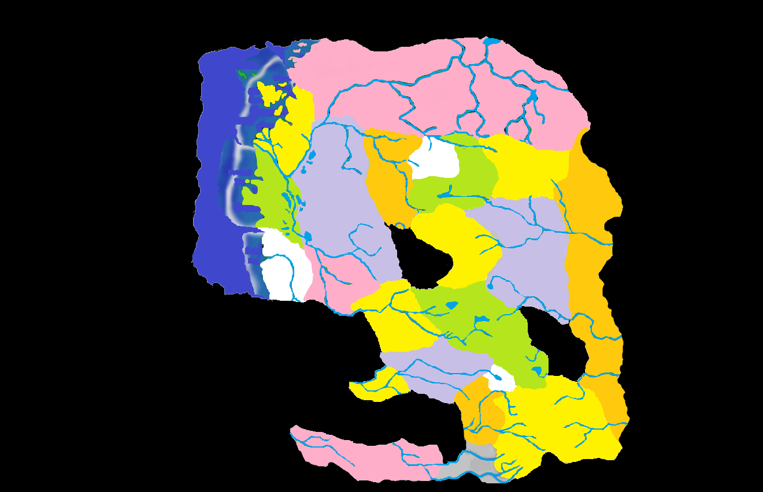
707 BC: Dementlieu Appears
Notes:
707 BC: Dementlieu, and its beautiful capitol Port-a-Lucine, appeared from the Mists in 707, instantly solidifying itself as a solid trading partner in the western Core. With a large population center, natural harbor and tremendous academic resources, Dementlieu became a cultural beacon. Nobles as far away as Nova Vaasa sent their heirs to Dementlieur boarding houses in order to pick up the refinement necessary to lead. Of course Falkovnia invaded soon after the appearance of the domain, prompting Dementlieu to form the Treaty of Four Towers with Mordent, Richemulot and Borca.

Slide 24
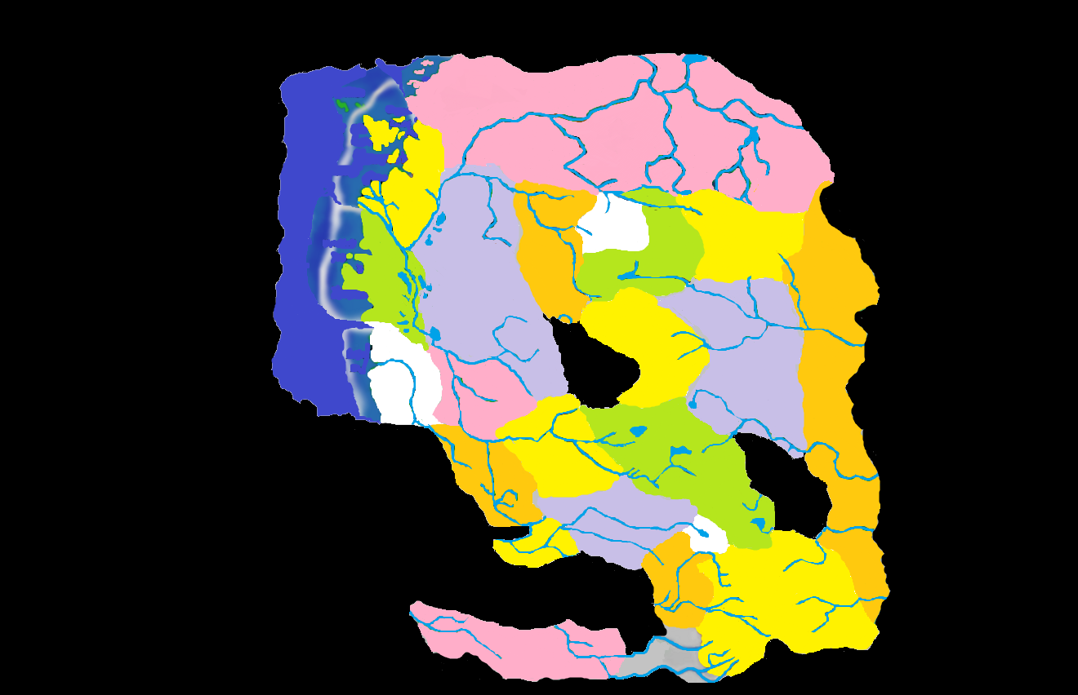
708 BC: Arkendale Appears
Notes:
708 BC: Mordentish ship captain Nathan Timothy had plied the Arden River when it still connected to Borca decades earlier. In an effort to unite Mordent with its river artery once more, he took his riverboat Virago into the Mists. Before him opened the rustic, rolling land of Arkendale. While it did not reconnect Mordent to the large river network, Arkendale did connect the rivers of the southern Core to those of the North, becoming a vital trade route from Kartakass to Lamordia or even Il Aluk. Though never heavily settled, this discovery made Arkendale locally famous, and its wolves equally infamous!

Slide 25
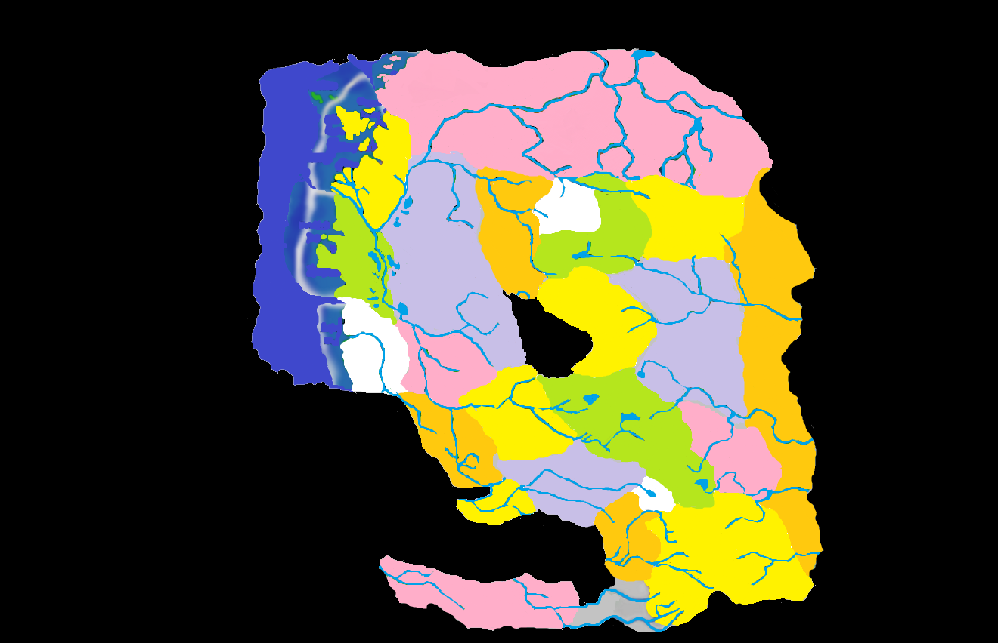
714 BC: Hazlan Takes Shape
Notes:
714 BC: Having already entered the Demiplane, the Red Wizard Hazlik had been trapped in the Nightmare Lands for some time before stumbling out of what had been Mist, but was now Hazlan. Iron Faith missionaries from Nova Vaasa moved south swiftly, not wanting to miss an opportunity to convert the new populace. They were surprised to find a people that already worshipped the Lawgiver, and spoke their language. The similarities ended there, as Hazlan was divided into two distinct castes of people, the ruling Mulan and the “underfolk” known as the Rashemi. Hazlan formed a loose alliance with Nova Vaasa and became a center for rare goods like spices and opium, and also for magic. Barovians tended to think of the Hazlani as witches and very seldom did any business with them.

Slide 26
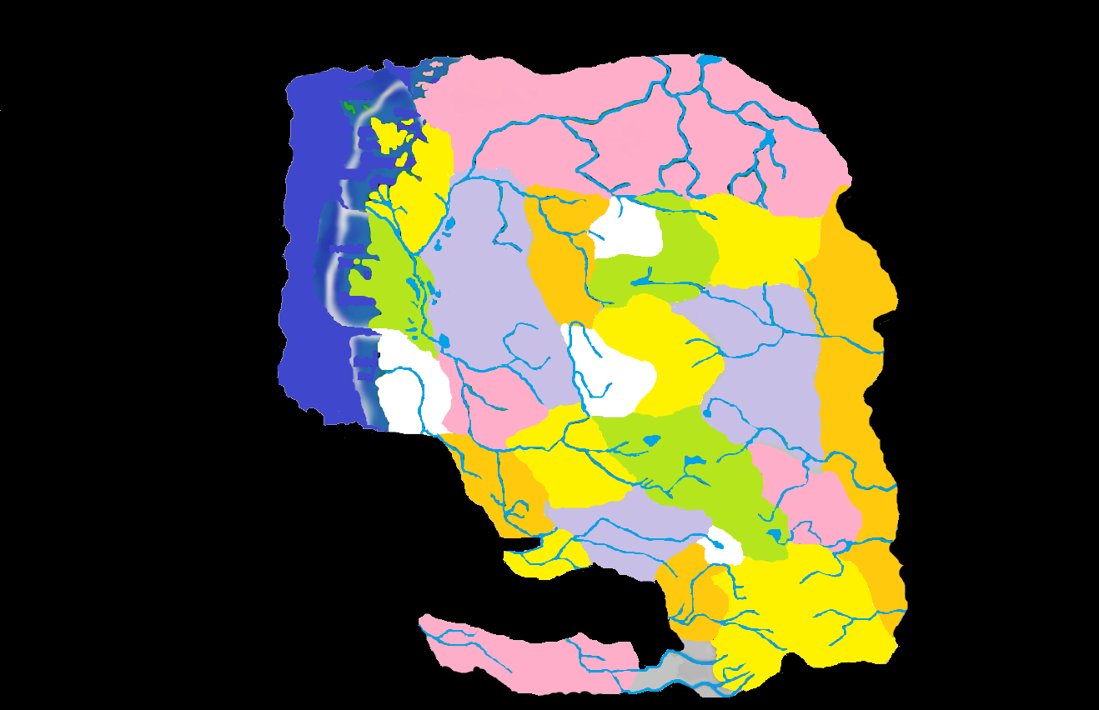
715 BC: Dorvinia Takes Shape
Notes:
715 BC: Since ancient times the Dilisnya clan were known as schemers and their lust for power was legendary. In Barovia the entire clan were considered enemies of the state after their betrayal in 351. It is therefore rather surprising that no action was taken whatsoever when Ivan Dilisnya founded Dorvinia right on the Barovian doorstep. Dorvinia was so like its sister nation, Borca, that it became a protectorate of Borca after the Grand Conjunction. This became something of a slight to Ivan, since it did not allow him to change the name of the pact to the Treaty of Five Towers, though he remains a staunch enemy of Falkovnia to this day.

Slide 27
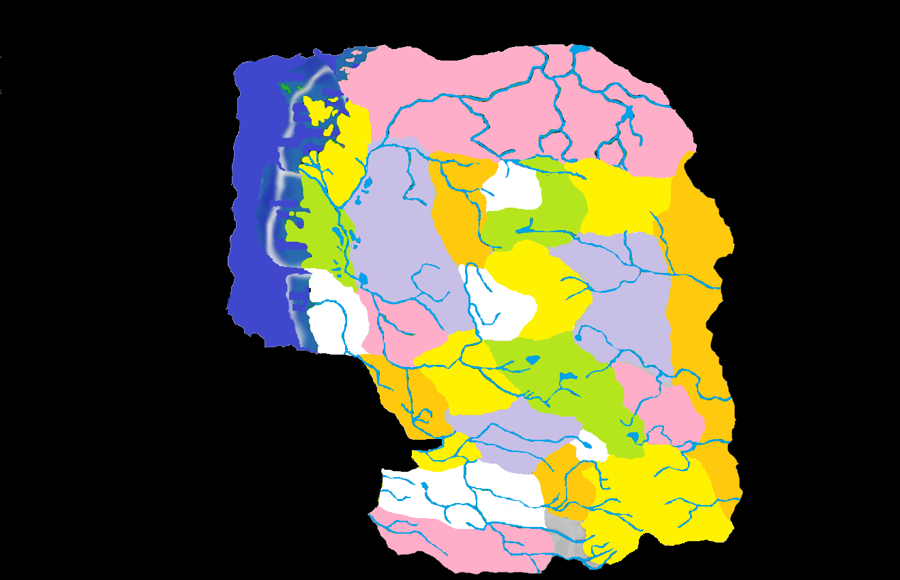
720 BC: Sithicus Takes Shape
Notes:
720 BC: The appearance of the Black Rose in Barovia led him into direct conflict with Strahd von Zarovich, and then Duke Gundar of Gundarak. The fallen knight slew Gundar’s son, Merdraut, before finally settling in the forested domain of Sithicus. Nedragaard Keep perched like a gargoyle over an imposing chasm, and the Black Rose largely left the people of the Core alone after claiming this land. Though the Vistani always referred to separate branches of great rivers as “the Musarde,” it was not until the appearance of Sithicus that the mighty river’s entire course from Bluetspur to Lamordia was uncovered. This initially brought merchants great joy, but the oppressive taxes and levies in Sithicus deterred most from trying to at last make a steady trading partner out of Valachan.

Slide 28
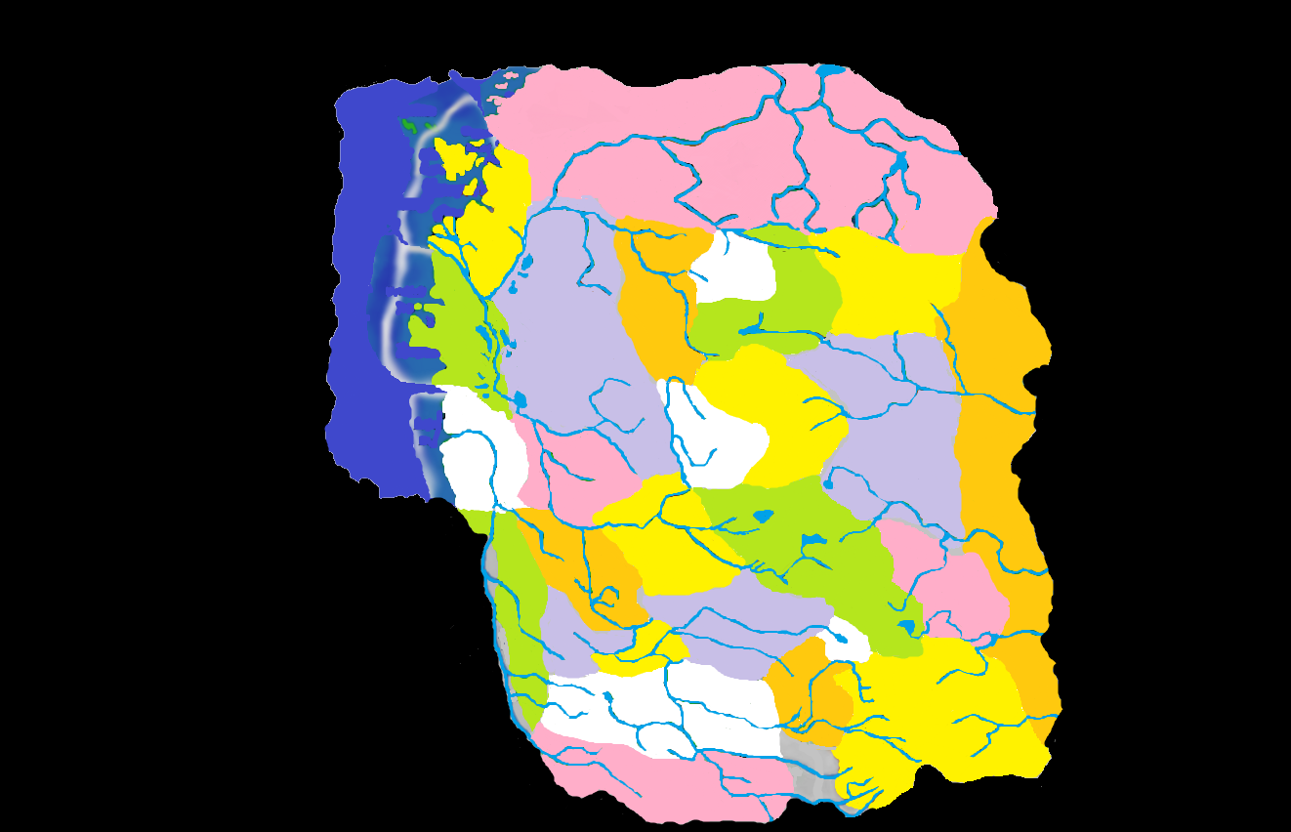
730 BC: Verbrek and the Nameless Sliver
Notes:
730 BC: Alfred Timothy, estranged son of Nathan, settled in the wilderness southwest of the land his father had made famous. This land, too, was sparsely populated and although he has disappeared from public view, most believe Alfred Timothy is still in these sorrowful woods. To the west and directly south of Mordent was a nameless sliver of land that held the misty headwaters of the Arden River, which had their source in western Valachan. This sliver was so desolate as to be effectively indistinguishable from its neighbor, Arkendale, and the Mordentish didn’t have the manpower to invest in a dedicated colonization. The land would give way to Valachan after the Grand Conjunction, and some say its existence prevented Valachan from spinning away into oblivion.

Slide 29
THANKS
The Fraternity of Shadows, particularly David “Jester” Gibson, whose map was used as the basis for my work. Without that “stencil” I’d have never had the artistic talent to present this.
John W. Mangrum, whose Unofficial Ravenloft Timeline was invaluable in helping to keep dates straight.
Zak “Lord Cyclohexane” Gillman, whose alternate formation ideas will be presented in a separate PowerPoint
This concludes the “Canon” version of the Ravenloft Genesis Project, which attempted to show the way the Core formed going strictly by the order each Core domain was formed and assuming they all formed in one general mass. These assumptions present a large number of difficulties, which may have been apparent while looking at the slides, but would become glaring if one were to read certain Ravenloft modules carefully. There are two more Genesis theories, one by Lord Cyclohexane and one by myself. While handy, these are presented just to show how it all makes sense to us individually and are not intended to replace canon, nor to change the way campaigns are run.
Matt “Strahdsbuddy” Doyle, 2011
Insert Legal Disclaimer Here

