Slide 1
Core Genesis Project
Theory II
Developed and Compiled by Matt “Strahdsbuddy” Doyle
This version of the Core Genesis Project focuses on my personal theory on the formation of the demiplane. Though it is the theory I use in my own campaign, it does not cleave terribly to the traditional views from canon timelines. However, with certain assumptions taken into consideration I feel it actually flows logically and helps deal with some rather quirky continuity issues and eliminates the need for some “false history” fudging. Enjoy!

Slide 2
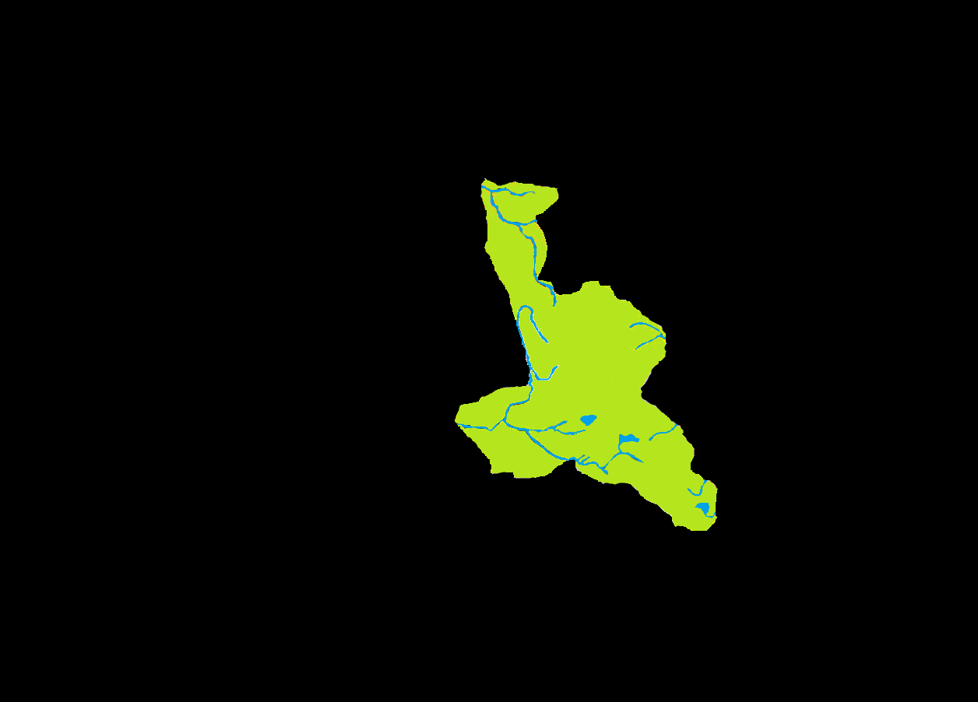
351 BC: Greater Barovia
351 BC: Greater Barovia
Notes:
351 BC: This chunk of land was hewn in whole from Barovia’s homeworld. It consists of Balok-speaking lands that had been a part of Old Borjia and lands where Strahd’s army would have encountered his Terg enemies while liberating his homeland. While more than twice the size of canonical Barovia, the future domains of Borca, Dorvinia, G’Henna & Markovia have very small populations, or none at all. The northern wilderness (future G’Henna) is not a desert at this point, but rather a dense forest like the evergreen-covered Balinoks south of it. Towns like Levkarest, Sturben and Lechberg are still small villages, and may have been jumping off points or supply depots for Strahd’s army. An important assumption for this theory is that while the land exists, it is not all technically part of Strahd’s domain. Politically, Strahd would not have considered the western portions to be rightfully his. Further, the manifestations of Tatyana would have only appeared in the southeastern portion of this land, leading Strahd to only focus his will in that area. By the time Borca becomes its own domain in 684, the majority of this land would have actually been ignored by its darklord due to his obsession with the object of his lust.

Slide 3

547 BC: Forlorn Formed
547 BC: Forlorn Formed
Notes:
547 BC: The appearance of tiny Forlorn seems even more insignificant in light of the Greater Barovia, however certain clues could lead to the reasoning that the two domains shared a homeworld. The events in Forfar at the same time as Barovia’s inception into the Land of Mists may have gotten the attention of the same Dark Powers who had been tempting Strahd. The evil at Castle Forfarmax and later the rise of Tristen apBlanc would be more noticeable to these Powers if they had happened on the same world. It is possible that Forfar and Borjia not only shared a homeworld, but that Alek Gwyllim may have actually been from Forfar before becoming Strahd’s lieutenant. If they were from the same world, it is not a tremendous stretch of imagination that the Dark Powers may have had some sort of deal with the gods of that world that permitted them to remove these evil creatures, a pact they would forge with gods of other worlds in the future.

Slide 4
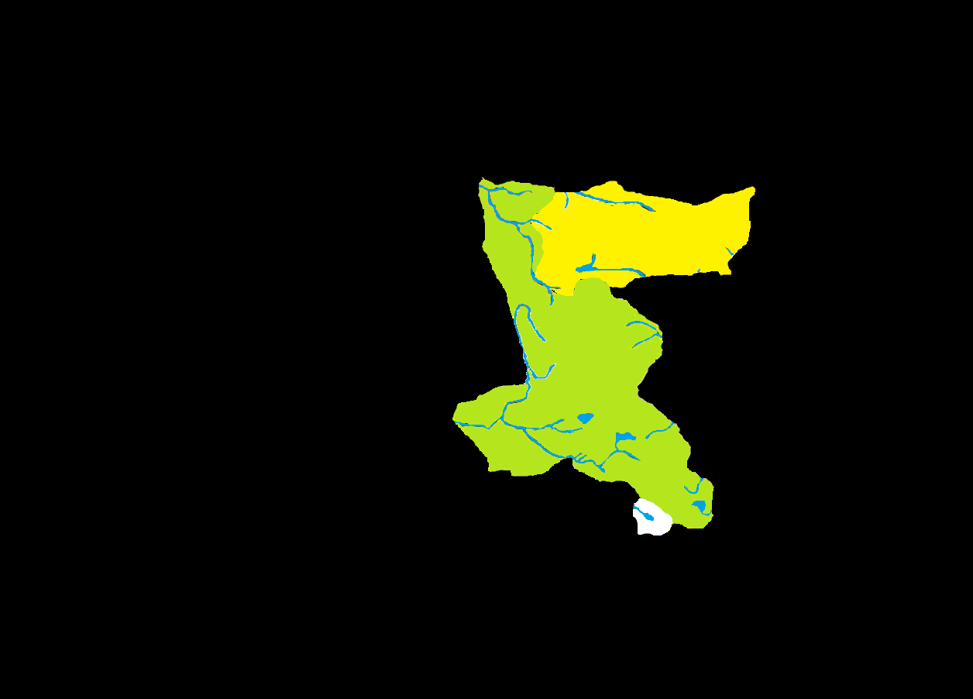
575 BC: Arak Appears
Notes:
575 BC: “Greater Arak” first appeared on the northern border of Greater Barovia in 575, complete with Mt. Lament on its western edge. Between the mighty peaks were the first Arakite settlements, most likely in what would eventually become Tepest. Tepest has a deep connection to the Fey, as though their existence had been a fact of life for a long time. Due to the cultural effects of the Fey and its general geography, it makes sense that the land itself could have entered with Arak. Mt. Lament would represent a place far from the seat of power for the two Courts of the Shadow Fey, so that the condemnation of Tristessa and her child was all the more symbolic in that they were executed not just above ground, but far from their kin. Due to the Temporal Fugue, the Shadow Fey had a tremendous amount of time below ground to expand their realm. Tunnels beneath northern Barovia would probably have been in place long before the “roof” came off (during the Grand Conjunction).

Slide 5
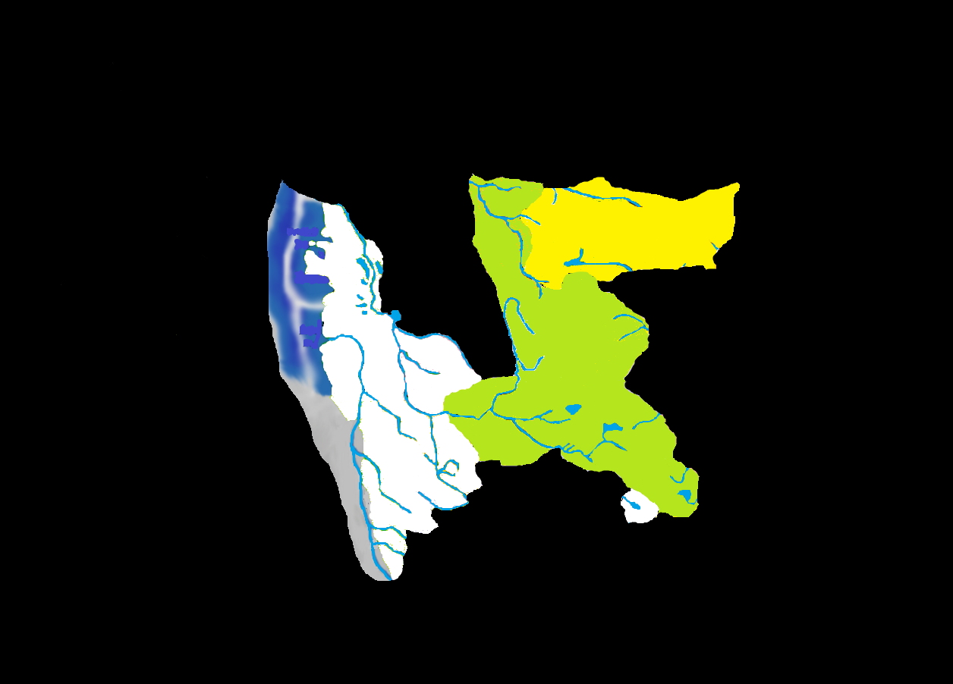
579 BC (Autumn): Greater Mordent
Notes:
579 BC (Autumn): On the canon timelines, Mordent is the only domain which is said to have “entered” Ravenloft. As opposed to other domains which “appear” or are “formed,” Mordent was more than likely dragged into the demiplane due to a link created by Strahd and Azalin in their final joint attempt at escape. This indicates that the Dark Powers themselves were not exactly all-powerful, and that they very nearly let two of their favorite playthings slip though their grasp. With Mordent dragged in by accident and Arak created intentionally by its residents (to escape from Gwydion), tiny Forlorn becomes the only land actually created by the Dark Powers in the nearly 250 years since the demiplane’s birth. Ironically, Azalin and Strahd may have actually shown their nemesis how to create or steal large tracts of land through this escape attempt. As for Greater Mordent itself, it is linked by people speaking one of the dialects of the Mordentish language and consists of future domains that will all be created for darklords already inside the Land of Mists. Though they share a border, the wilderness between the growing town of Levkarest and the tiny village of Mordentshire or the soon to be vital town of Port-a-Lucine would prevent Barovian (or Borcan) residents from realizing the new neighbor was anything more than trackless forest like Forlorn. Greater Mordent was probably hewn in whole from its homeworld, leading to a sort of “lost colony of Roanoke” myth that would surround its disappearance. The superstitious Mordentmen were not immediately an adventurous lot, and would have probably considered the mighty Musarde River to be a natural border to their colony, completely ignoring the forest to their south, often called “the Dark Dale”, eventually colloquialized as “Arkendale.”

Slide 6
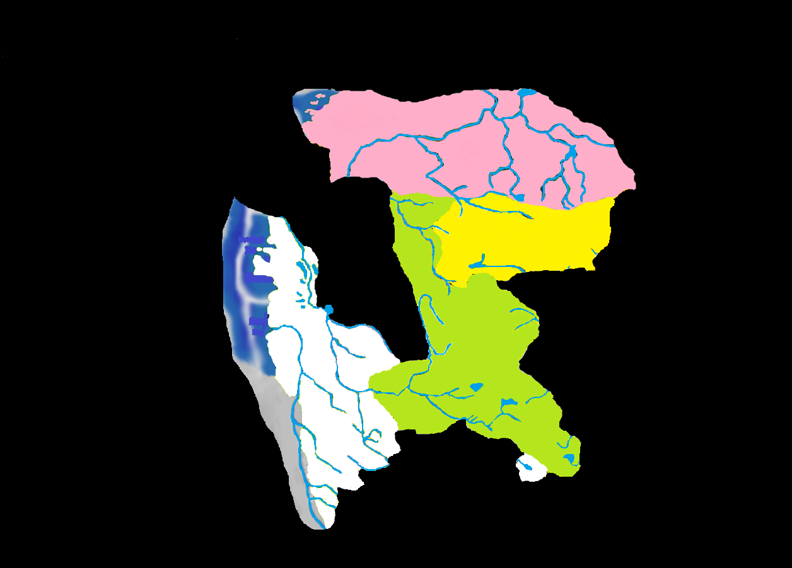
579 BC (Winter): Darkon Appears
Notes:
579 BC (Winter): Azalin figured that Strahd’s curse was the anchor around his neck preventing him from escaping, and decided to abandon the vampire after their disaster in Mordent. He realized too late that he had walked into the Dark Powers’ trap. There is no telling how long it took Azalin to assert his power over Darcalus and take power in Darkon for himself, or if it even happened anyplace besides his own mind. Darkon is essentially “Greater Darkon” unto itself, although after the Grim Harvest it did break down into smaller domains for a short time before Azalin returned and re-asserted power. The border shared with Barovian wilderness would have made for an excellent staging area for any “war” that may have taken place between the two nations, as well as acting as a buffer against the populated area of southern Barovia. Eventually Azalin gave up actively pursuing his rivalry with Strahd and turned his attention back to escape.

Slide 7
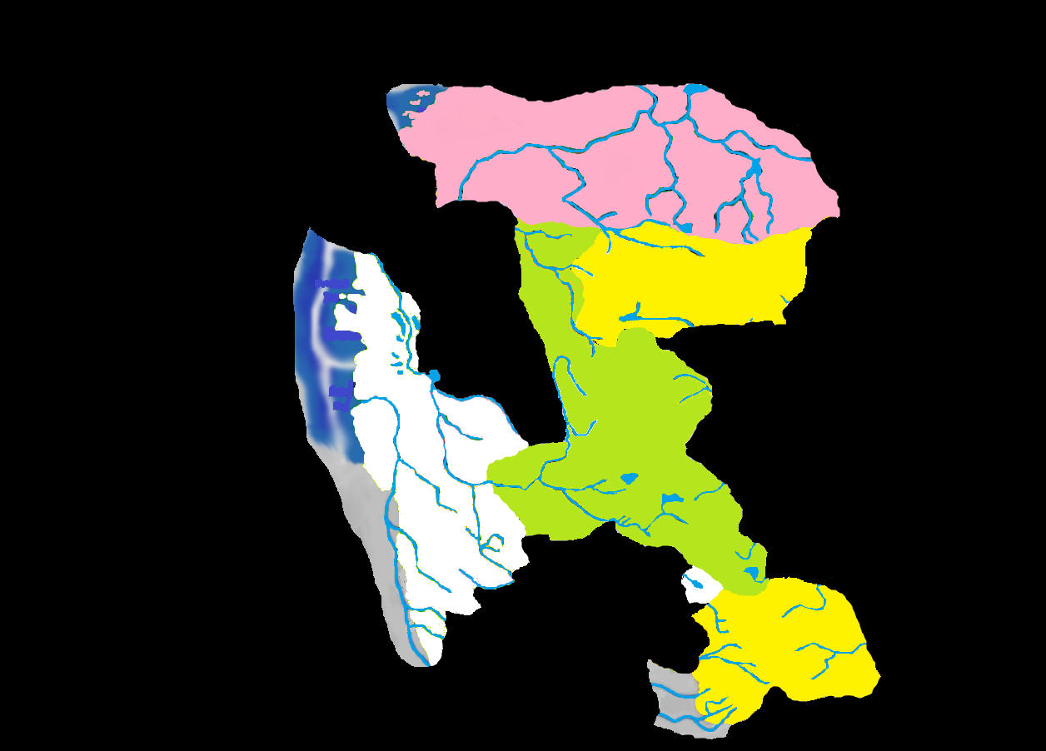
581 BC: Illithids Spawn Bluetspur
Notes:
581 BC: Like Mordent, Bluetspur has a unique term attached to its formation; it is the only domain to have been “spawned.” This could indicate again the intentional creation of the land by creatures that were already in the demiplane. More than once it has been suggested that the Illithid are resident’s of Ravenloft’s moon. Bluetspur could have been an attempt to manifest their influence on the humans beneath them. In fact, it may even be an actual piece of the moon hurtled toward the surface through some Illithid spelljamming technology. Or, another land could have existed there prior to Bluetspur usurping it. That land may have been Thaan, or the Thaani could have been a race subjugated many years before and there are more of their gifted kind laboring beneath the Mind Flayers wherever Bluetspur originated.

Slide 8
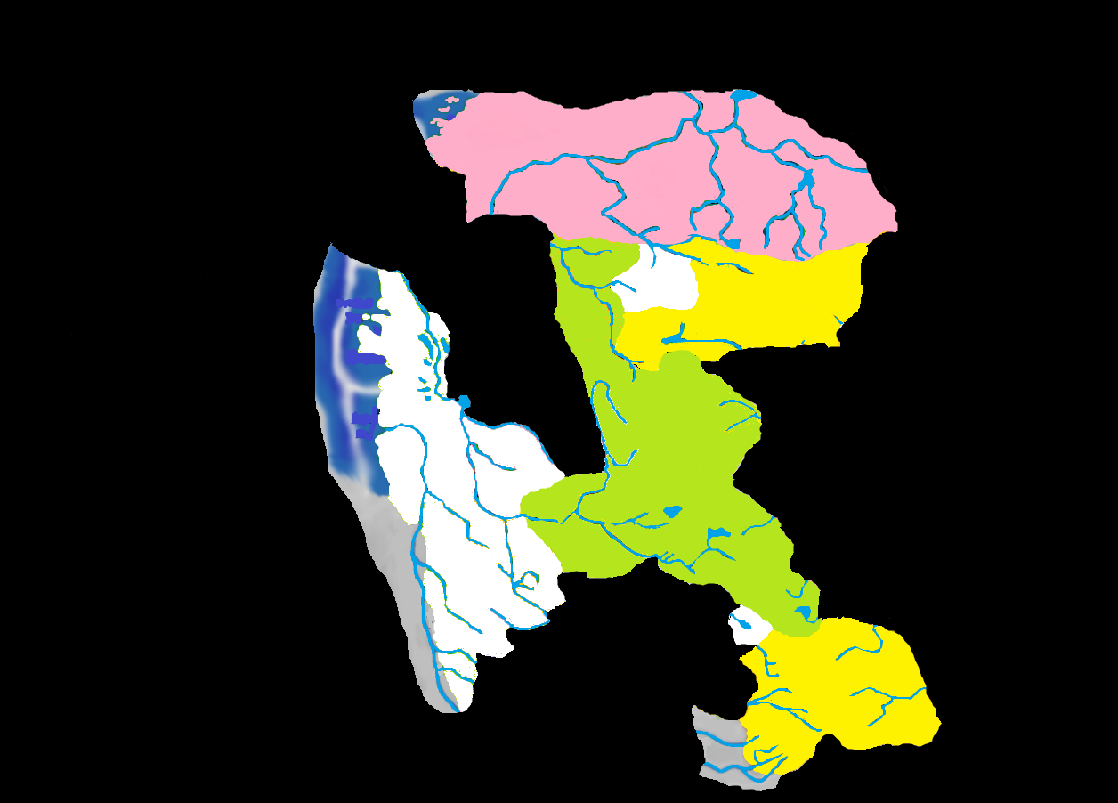
588 BC: Keening Appears
Notes:
588 BC: As mentioned before, Mt. Lament would have been far from the center of the Shadow Fey’s Courts, and this is the likely reason it was chosen as the site of Tristessa’s execution. The human town at the base of Mt. Lament was close enough to the source of the Banshee’s destruction that not only was the entire population slain, they were immediately reanimated in undeath. By the time the Scourge of Arak had spread to the rest of the domain, it was still powerful enough to kill every living thing on the surface, though not to reanimate them. This blasted Arak would remain so for over 100 years, until three foundlings began tampering with the boundaries of morality and created Tepest.

Slide 9
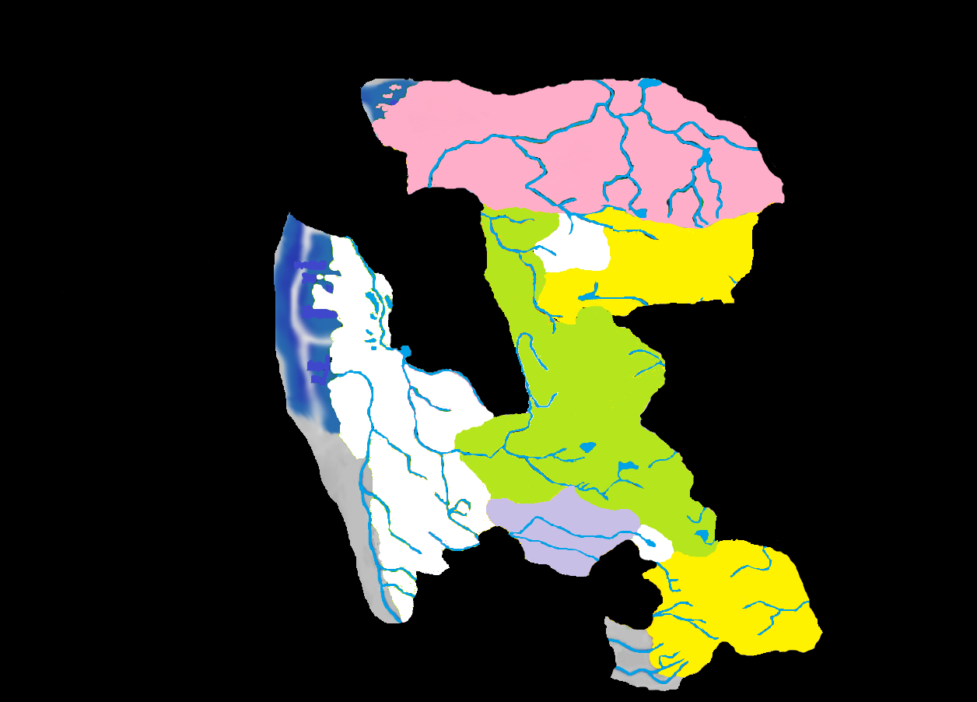
593 BC: Gundarak Forms
Notes:
593 BC: Duke Gundar entered Ravenloft from an un-named world near the Barovian village of Krezk. After a brief encounter with Strahd, he fled into the Mists and discovered Gundarak. Little is known about Gundarak, though people in other parts of the Core had a difficult time telling the difference between a Barovian and a Gundarakite. The people of Gundar settled into a relatively quiet existence, occasionally venturing into neighboring domains for lumber or trade to satisfy the taxes of their cruel ruler.

Slide 10
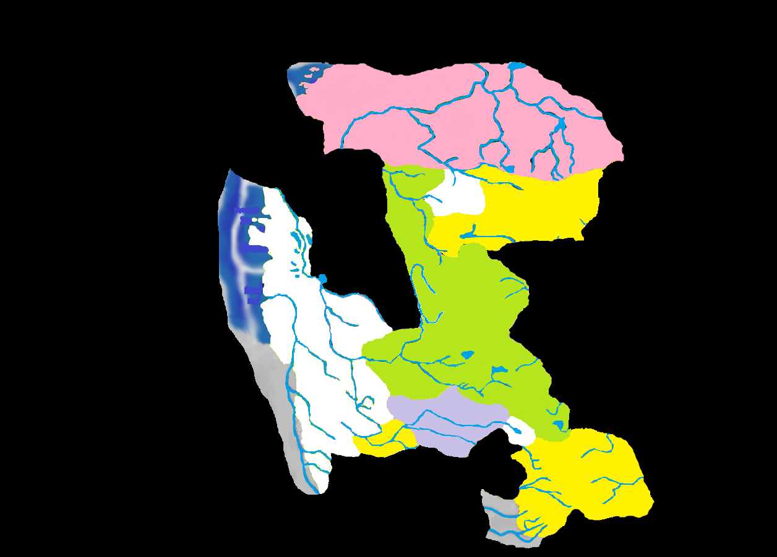
603 BC: Invidia Takes Shape
Notes:
603 BC: The cursed werewolf, Bakholis, became lord of Invidia, although it is not clear if he was already in Ravenloft. It is doubtful he was Mordentish, as the werewolves that had been there since before the events of 579 were natural lycanthropes. The brutal Bakholis reveled in his new abilities, creating werewolf shock troops that did his bidding and enforced his laws. The overzealous werewolves came into conflict with Gundarakite vampires, and an animosity between the two nations persisted until the murder of Bakholis in 729 BC by the half-Vistana witch, Gabrielle Aderre.

Slide 11
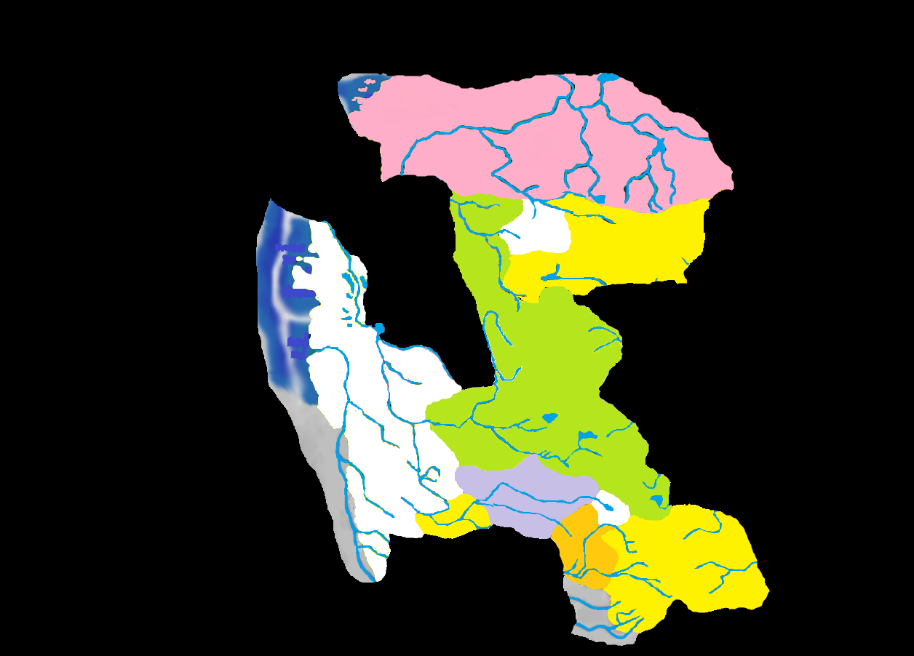
613 BC: Kartakass Appears
Notes:
613 BC: Harkon Lukas had been in Barovia and other parts of the southern Core since 610, sowing dissent and generally wearing out his welcome with some of the more hands-on rulers like Bakholis, Gundar and von Zarovich. Lukas was duped into entering the Mists in 613, resulting in his imprisonment in Kartakass. The realm appealed to him and he settled into more subtle schemes, deflecting the occasional incursion from greedy Gundarakite axmen. Lukas became the trend rather than the exception: a domain lord that did not receive his domain until he had already spent some time in the demiplane. This may be an indication of a shift for the Dark Powers, although they had at least one more major raid on another world yet to perform.

Slide 12
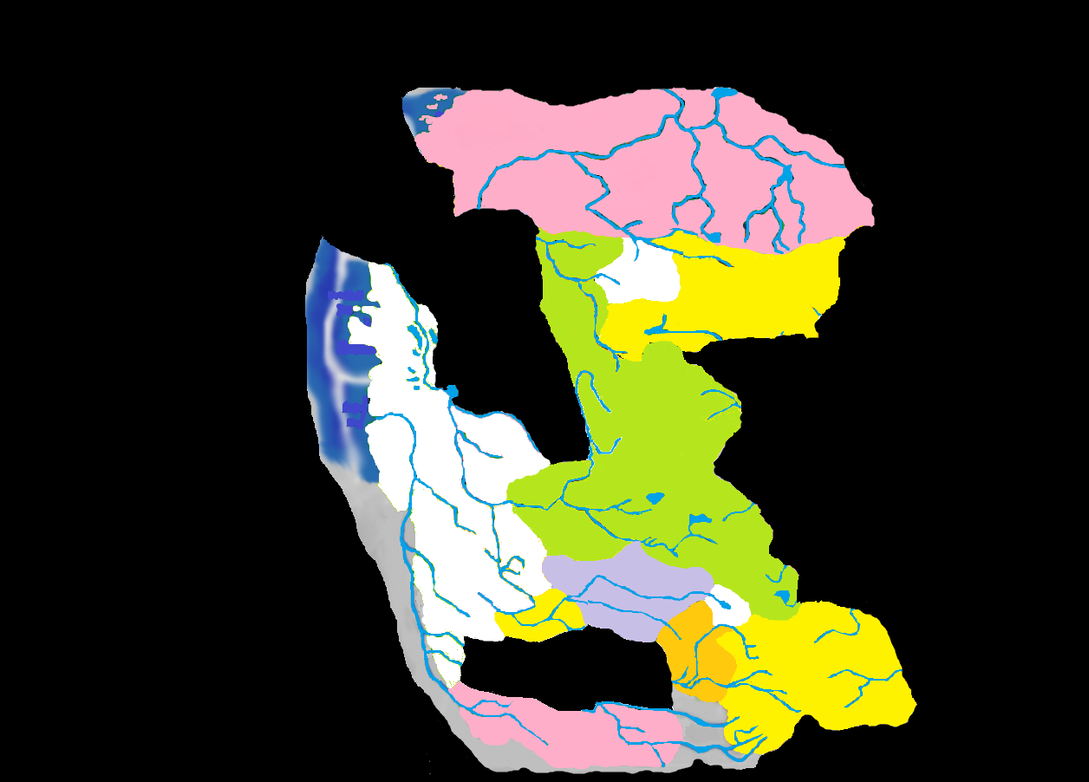
625 BC: Valachan Takes Shape
Notes:
625 BC: Originally from Toril, Urik Von Kharkov had been turned into a vampire by his Kargat master in 605. When his master was slain he fled into the Mists and was granted the domain of Valachan. Isolated from the rest of the Core, bordering only an uninhabited sliver of Greater Mordent and having tenuous river connections to Bluetspur, the Valachani people became very self sufficient and the purity of their unique racial characteristics was not polluted with other bloodlines. Their lord instilled in them a national pride that helped increase the value of their independent nature, and in return they ironically followed his orders implicitly.

Slide 13
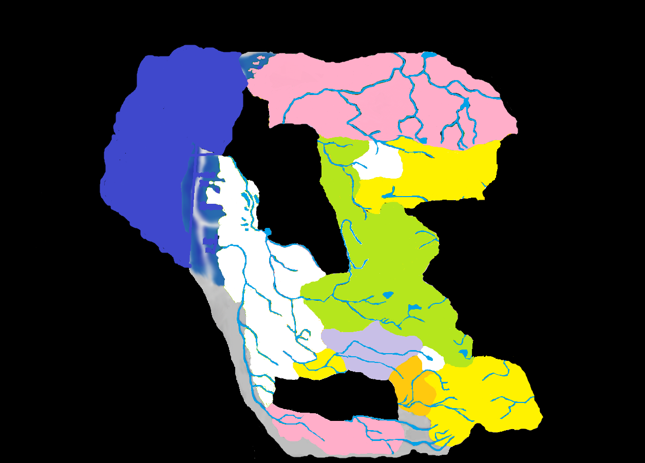
630 BC: Sea of Sorrows Forms
Notes:
630 BC: Though the coasts off Darkon and Greater Mordent had been traveled for centuries, it was not until 630 BC that the cold, stormy Sea of Sorrows finally took shape, although that shape was quite mutable and even to this day it has never been fully mapped. Islands tended to appear and disappear randomly, dampening the excitement surrounding their discovery. In the future, as the Land of Mists seemed to settle down, and particularly in the mid-700s, sea travel became a much more stable venture. At this point, however, sailors were happy with the relatively safe sea route between Martira Bay, Mordentshire, and the fast-growing Port-a-Lucine.

Slide 14
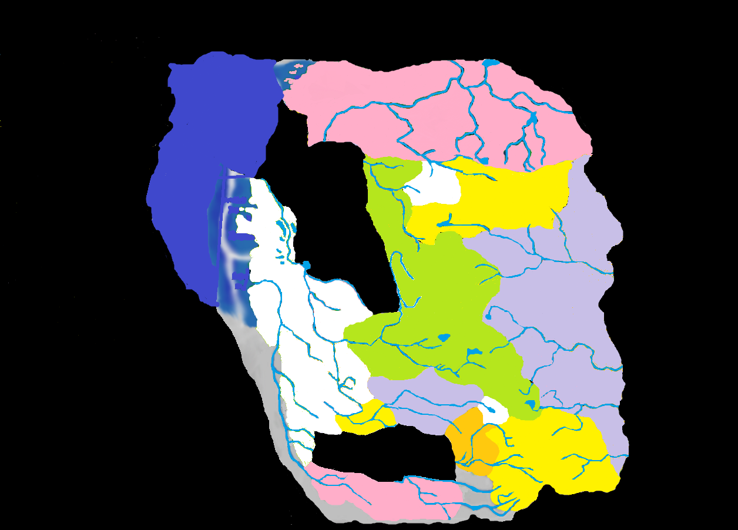
682 BC: Nova Vaasa Appears
Notes:
682 BC: It is unclear what sort of bargain the Dark Powers made with the gods of Toril, but after capturing a number of individual citizens of that world, finally in 682 the Dark Powers captured the land of the Vaasi. Nova Vaasa was initially a large and relatively heavily populated domain, rivaling Darkon in size and people. Unfortunately for the Five Families of the Vaasi, an unnatural opponent was going to make life in their new home terrifying and dangerous….

Slide 15
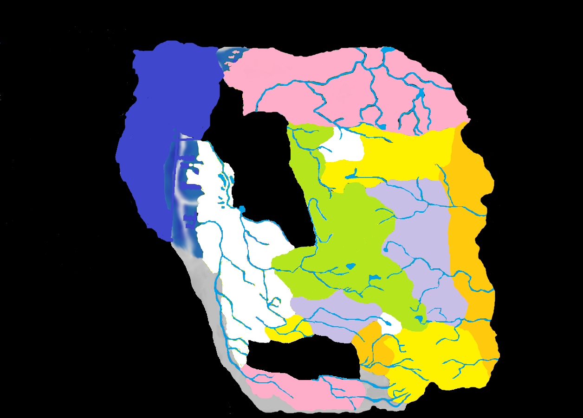
683 BC: Nightmare Lands Join the Core
Notes:
683 BC: What started as a tiny sliver along Nova Vaasa’s border with Darkon had within one year spread to consume the entire eastern half of the domain. Rather than taking over the land itself, the Nightmare Lands squeezed Nova Vaasa’s cities closer and closer to one another, like a weird battering ram attempting to smash the fledgling domain against the unforgiving Balinoks. It is not known how long the Nightmare Lands had existed in the Mists, but their appearance with Nova Vaasa led the rest of the Core to assume the Vaasi had brought this terror with them. This strange land would exist for more than fifty years before the Grand Conjunction finally cut it from the Core like a tumor, restoring most of Nova Vaasa. The unique native population, the Abber Nomads, were unlike any other Core population in language or appearance.

Slide 16
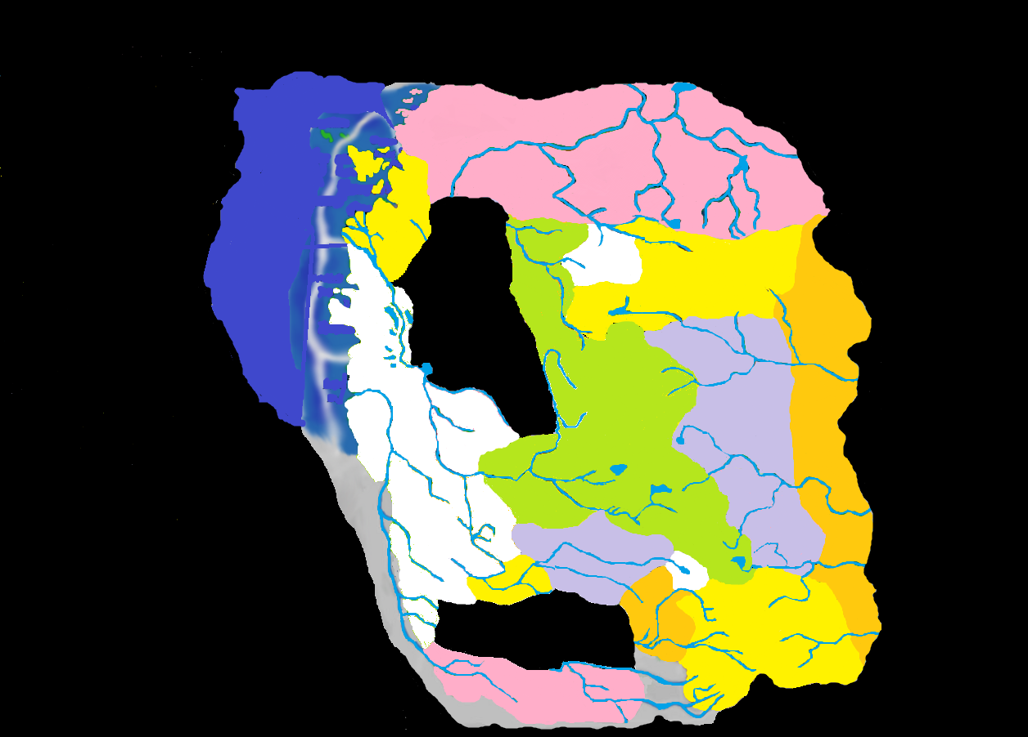
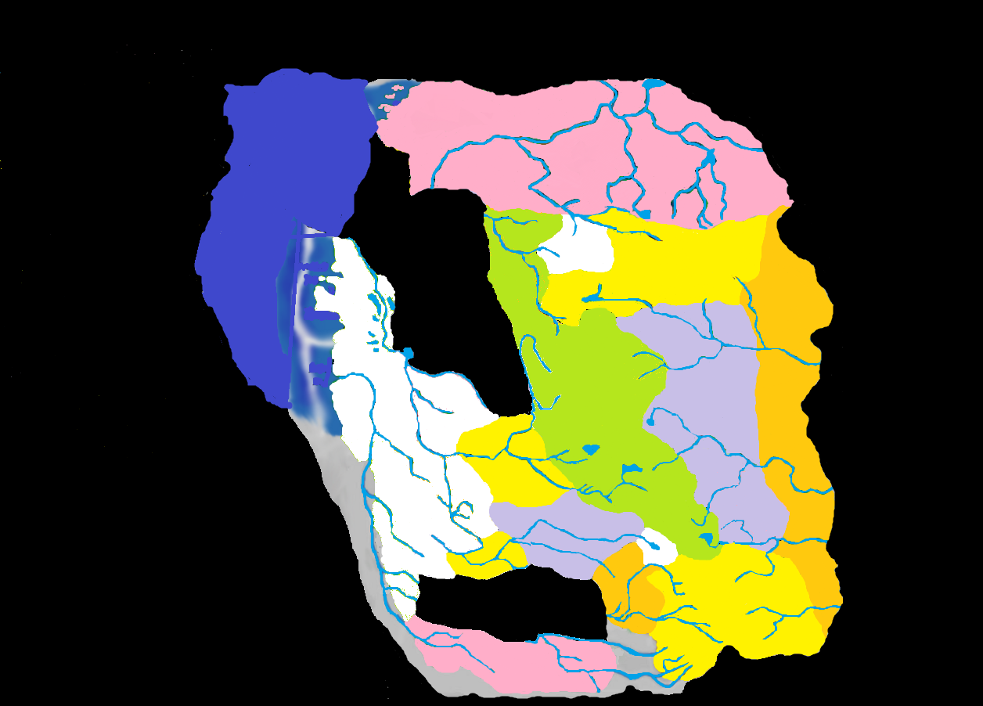
684 BC: Borca Appears
685 BC: Lamordia Appears
Notes:
684 BC: Though it had existed alongside Barovia for 333 years, isolated from their direct liege, Borca did not become its own domain until 684. Though the taxes had been collected dutifully, with no one to turn them over to the money instead lined the pockets of several rising merchant families, particularly the Boritsi. With the death of her husband in 684, Camille Boritsi began effectively buying out the other merchant families. By the time her daughter, Ivana, took power in 711 all the property in Borca belonged to the Boritsi. As mentioned earlier, Strahd never believed this sliver of his homeland to be part of the land he liberated from Dorian, and the domain had been completely autonomous for centuries, although it had no known darklord.

Slide 17
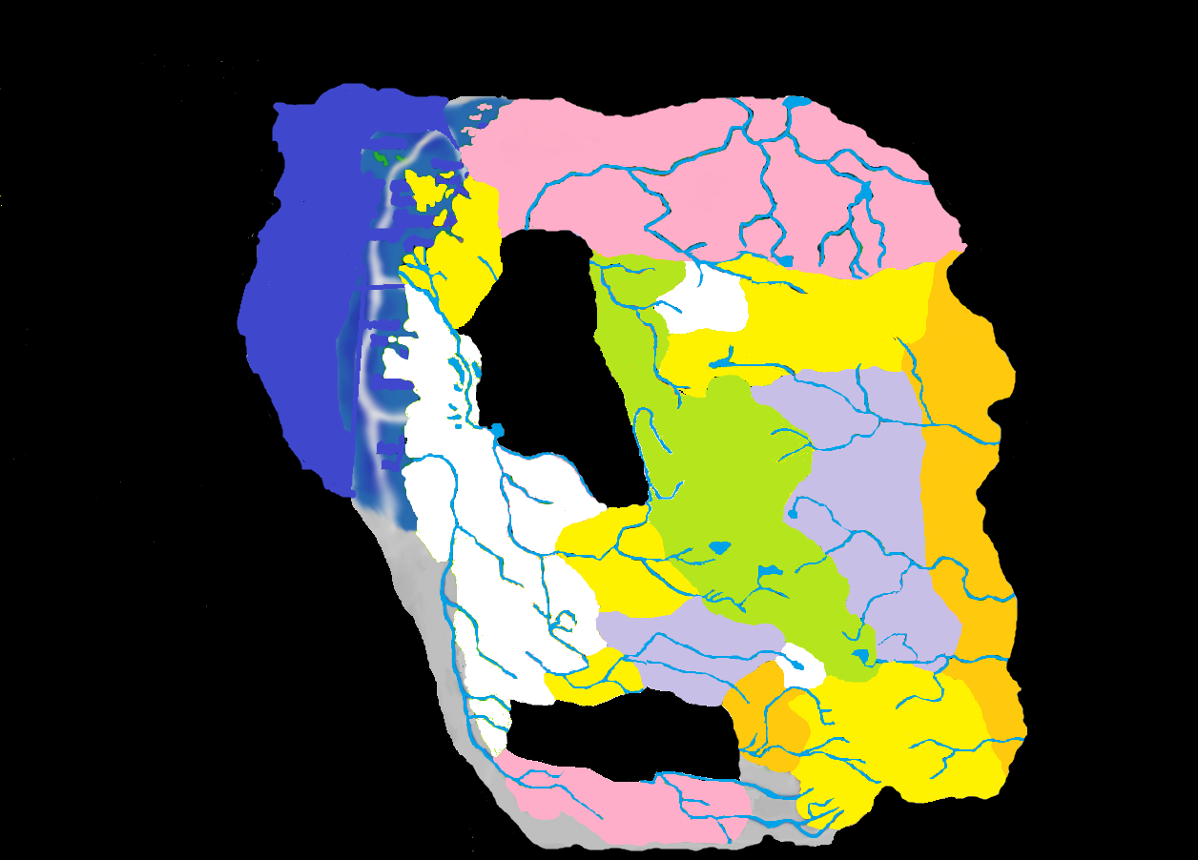
685 BC: Lamordia Appears
Notes:
685 BC: The small domain of Lamordia, whose date of arrival has been argued, introduced advanced medicine to the Core. Its position along the Sea of Sorrows increased the value of the Sea lanes, as well as providing the Musarde Delta, which in spring allowed loads to be taken directly into the sea, rather than disembarking east of the ever-growing city of Port-a-Lucine. It is important to note the misty gap in the middle of the Core. Though there is no evidence to support it, this gap may have been home to some lost domain, like Theka or another of those mentioned in NMNB. Alternatively, it may have even been host to a physical manifestation of the Silver Kingdoms Drakov claims to have formed Falkovnia from. The more important point is the Shadow Rift was not the first donut hole in the Core, although it was the first to result from the removal of domains rather than the Core just forming around it.

Slide 18
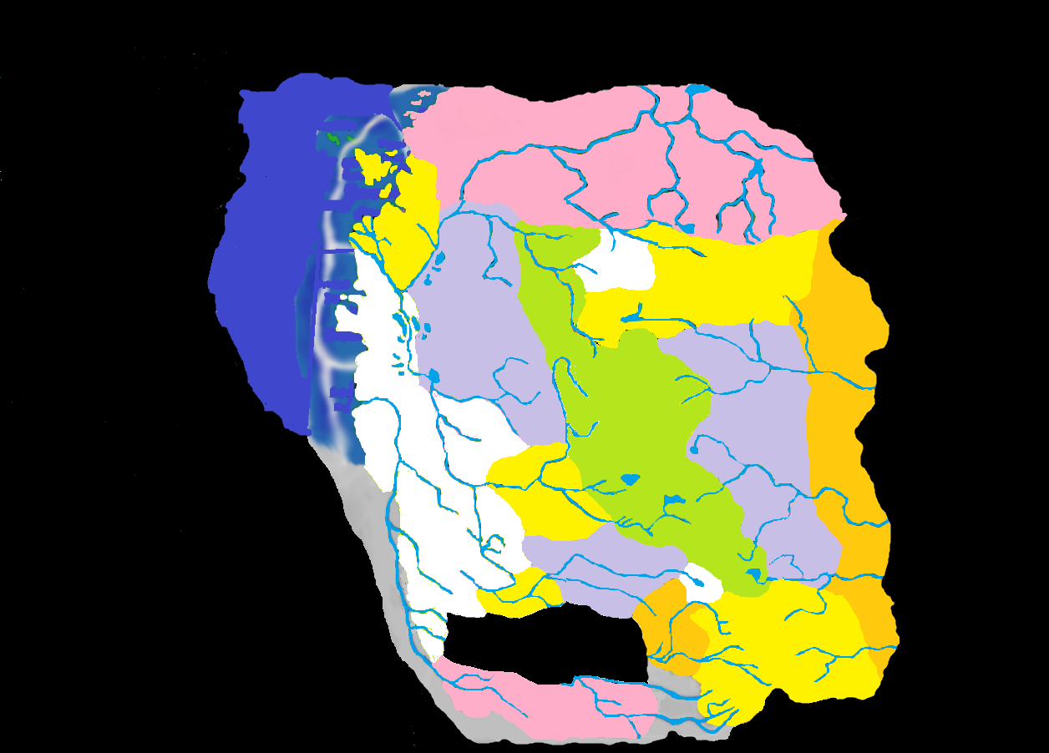

690 BC: Falkovnia Appears
690 BC: Falkovnia Appears
Notes:
690 BC: One year after Vlad Drakov first arrived in Darkon, he and his brutal army of mercenaries were driven south into the Mists. The idyllic domain of beautiful forests and great tracts of arable land was soon reorganized under Drakov as a harsh dictatorship. The peasantry was pushed to the limits of human decency, and often beyond, all for the greater glory of their vicious king. Drakov had one military victory, often overlooked by historians. His talons occupied and erected an outpost on the southwestern shore of what was renamed Lake Kriegvogel, allowing Falkovnia to control river commerce along the Musarde. There was no resistance from Mordent, and this tiny shred of victory has tantalized Drakov in all of his future military failures.

Slide 19
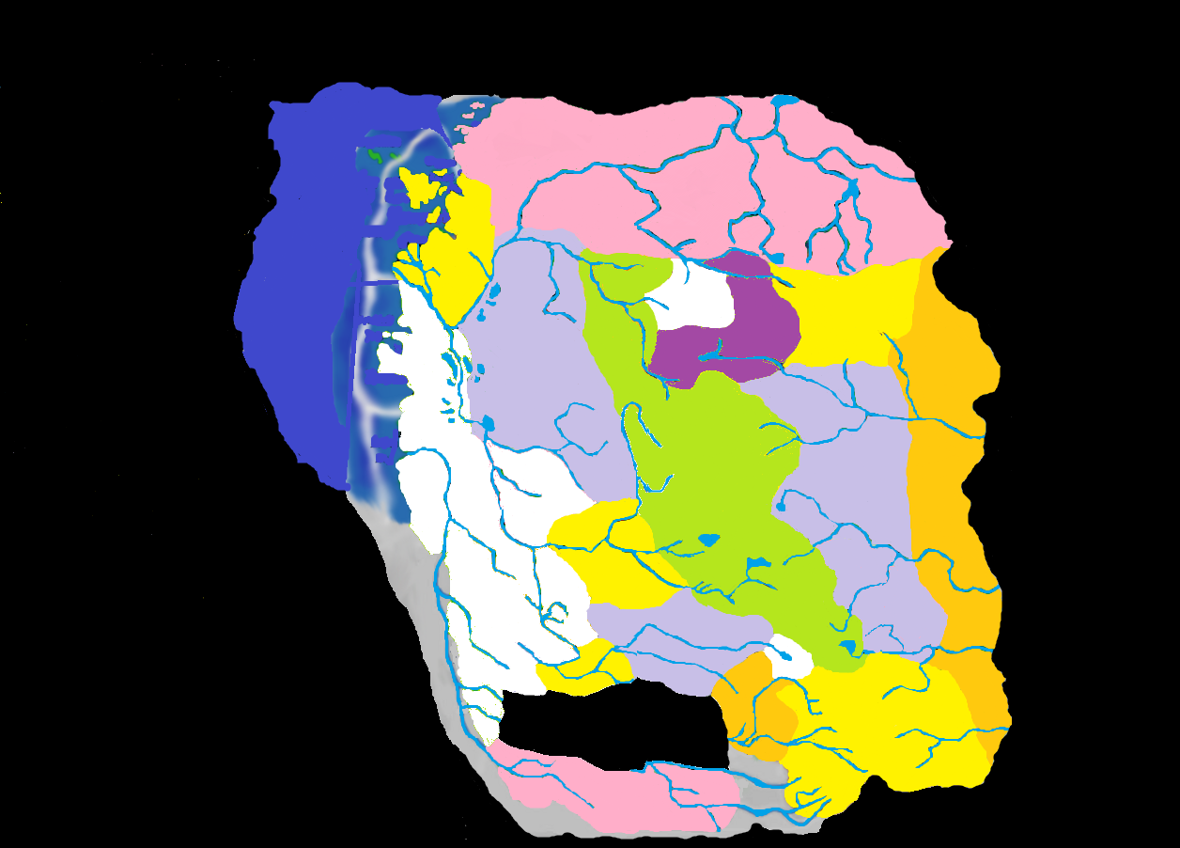
691: Tepest Appears
Notes:
691 BC: Since the Scourge of Arak over a hundred years prior, the area had been shunned as haunted. Aside from the occasional group of lumberjacks testing the quickly growing forests, it was not until 691 that humans tried settling this area. Calling the land “Tepest”, these newcomers had little in common with their neighbors aside from a consuming fear of the night. Tepestani children grew up with a multitude of tales about evil spirits and goblins and other unnamed horrors that stalked the woods. It can be assumed that these tales refer to the Shadow Fey who had lived beneath the area since its appearance and by this time had spread to nearly every corner of the Core.

Slide 20

694 BC: Richemulot Appears
Notes:
694 BC: Drakov chased Claude Renier and his wererat clan from Falkovnia’s sewers in 694, and they headed south in search of safer hunting grounds. Settling in the eastern area of Greater Mordent, they founded Richemulot. Renier’s ancestor had actually founded the town of Mordentshire centuries ago, and the new nation was friendly to their neighbors in the west. The cities in Richemulot were spacious and ancient, and no Mordentish records indicate any clues to their construction. The new domain became a place for people looking for a fresh start, and is now something of a melting pot.

Slide 21

698 BC: Markovia Forms
Notes:
698 BC: The second domain to emerge from Greater Barovia was Markovia. Going with the theory that Strahd’s interest in the outlying portions of this larger landmass due to Tatyana’s spirit never being reincarnated there could be one reason his power here was not as strong. The Monastery where Strahd confronted Leo Dilisnya was on the northern flank of Mt. Baratak 300 years prior, and that may well be the last time Strahd was this far north himself. When the crimes of Frantisek Markov were discovered he fled into the wilderness, and the land embraced him. Because it was wilderness before and it had no human population of its own, the fact that Markovia had become a separate domain most likely went unnoticed by the majority of the populace. This may actually be the beginning of the hibernation Van Richten believed Strahd to be in the middle of when he entered Castle Ravenloft in search of his diary. The events in greater Barovia over the course of the next two decades would certainly indicate that Strahd may have been unable to do anything to stop the smaller domains from being created, if such a thing even interested him.

Slide 22

702 BC: G’Henna Appears
Notes:
702 BC: Shortly after the formation of Markovia, Yagno Petrovna was chased into the Barovian wilderness by his family. He may have crossed through Markovia, or possibly run from more civilized lands, like Lechberg. At any rate, unlike Markovia, when G’Henna was created it was quite noticeable. What had once been dense forest was blasted clear of large vegetation, creating an arid realm where the worship of Petrovna’s strange god was the center of society. The towns of Dervich and Zhukar were already populated with Balok-speaking worshipers of Zhakata, just the way Petrovna imagined the religion would be. The Timori Road, which had just been a trampled path through the woods before, became a major highway, allowing trade over the Balinoks, and in particular between Nova Vaasa and Falkovnia, though a tariff on both foodstuffs and horses was enacted in G’Henna, for the glory of their god.

Slide 23

707 BC: Dementlieu Appears
Notes:
707 BC: The city of Port-a-Lucine had been a tiny fishing hamlet, smaller than Mordentshire, when drawn into the Mists. Over the course of a century it had grown in size and prestige, eventually becoming a beacon of cultural pursuits. In a bloodless coup, the land of Dementlieu “seceded” from Mordent and established independent government. Most nobles had already emigrated north anyhow. Mordent’s darklord, Wilfred Godefroy, concerned himself primarily in the area around Gryphon Hill, and his interest in outlying areas of his domain (if he even realized it was his domain) was non-existent. When Falkovnia unsuccessfully attempted to expand its border to the mighty Musarde River, Dementlieu entered into a mutual defense pact, the Treaty of Four Towers, with Richemulot, Borca, and their cousins in Mordent.

Slide 24
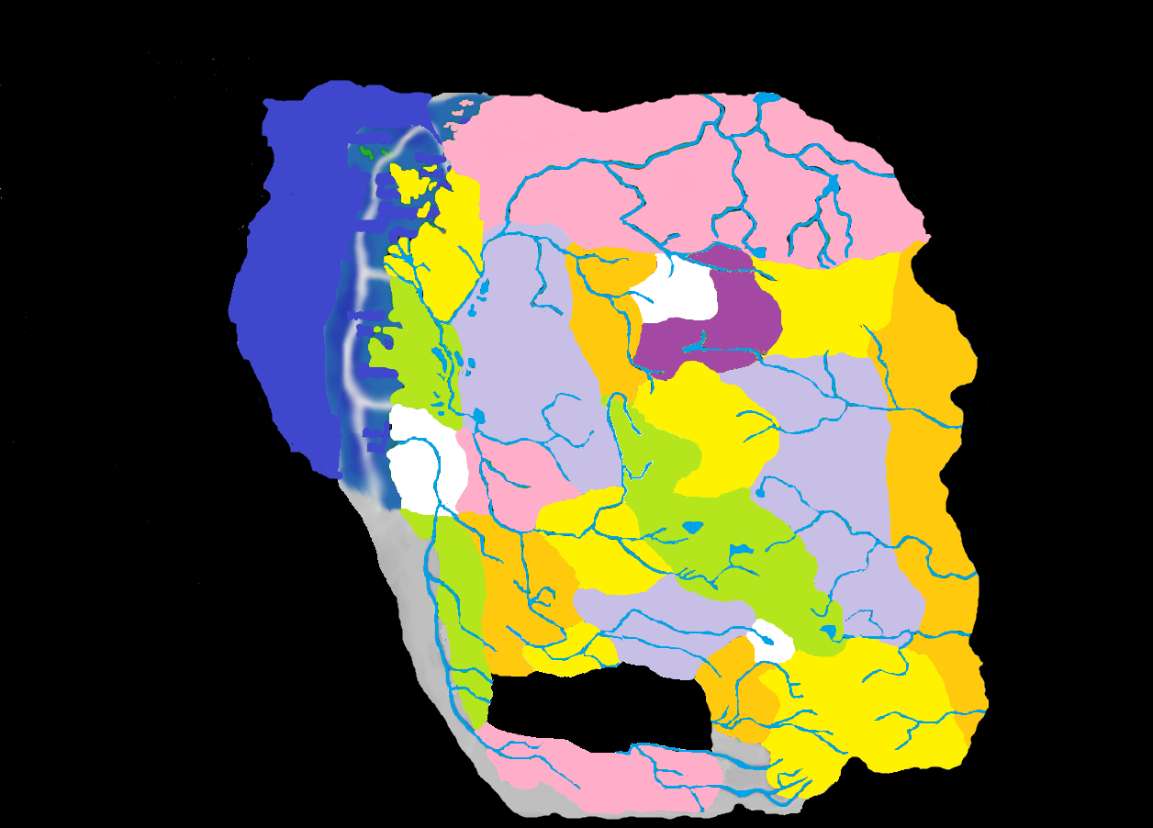
708 BC: Arkendale Appears
Notes:
708 BC: By 708 the sparsely populated southern portion of Greater Mordent was no longer in any way related to its more civilized cousin. Since its days before the Mists, the area had been avoided by Mordentmen, and had become a haven for vicious creatures of all types. Nathan Timothy became darklord of Arkendale in 708, and the nameless sliver of land to its west, though no darklord was ever identified, was as much a part of Mordent by this time as Barovia was. Timothy sailed the Musarde in his riverboat Virago , and due to the lack of civilization, few people noticed this dense forest had actually become its own domain.

Slide 25
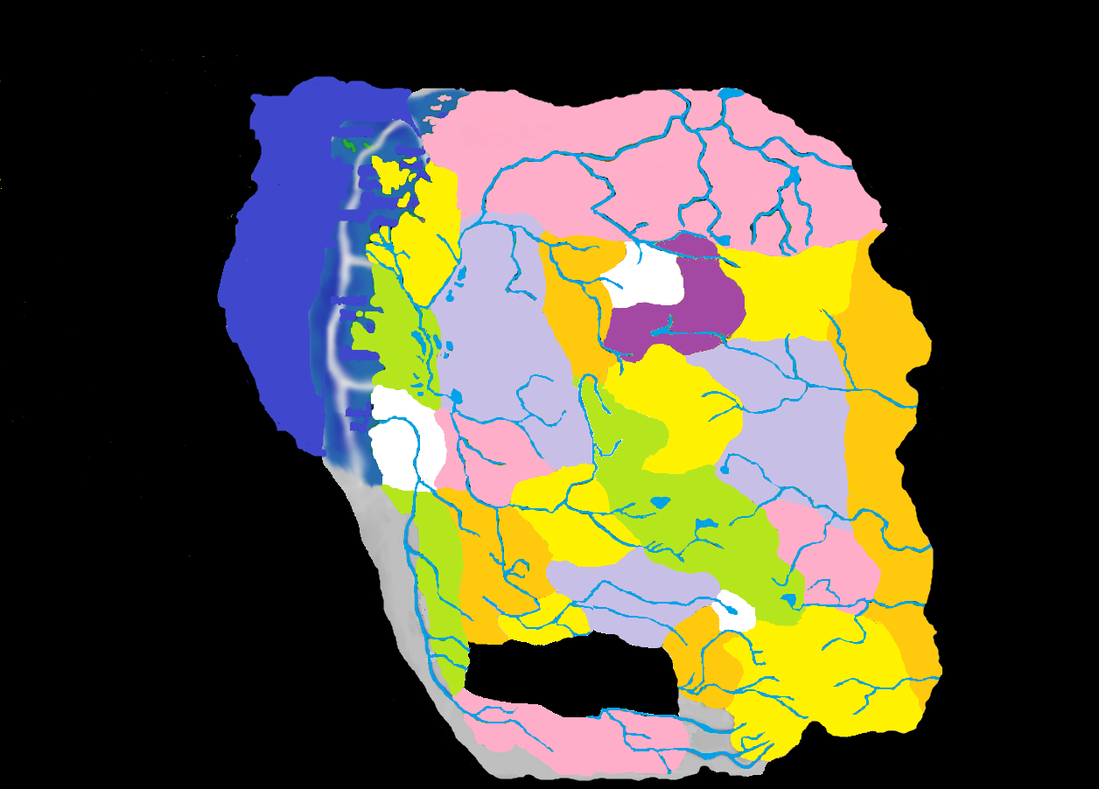
714 BC: Hazlan Takes Shape
Notes:
714 BC: The Red Wizard, Hazlik, had fled Thay on Toril only to end up in the Nightmare Lands. Haunted by visions of his humiliation at the hands of his enemies, he fought off numerous creatures and finally found his way into southern Nova Vaasa, in a land that seemed to be prepared for him. Hazlan had the same ethnic divisions as his native Thay, and the nation to the north shared both a language and religion with him. The Hazlani were otherwise mistrusted, particularly by the arcanophobic Barovians. This limited their trade, as all their goods were first filtered through Nova Vaasa (And Vaasi taxes).

Slide 26

715 BC: Dorvinia Takes Shape
Notes:
715 BC: There should be no more need of proof that Strahd was in hibernation than the emergence of Dorvinia. The Dilisnya had been in hiding since 351, and when one of their own became ruler of Borca (Camille Boritsi had been Camille Dilisnya) and no retaliation had come from the Barovians, they took it as an all-clear signal. Having been scattered across the Core, a familial call to arms went out, and 29 years after the formation of Borca came the formation of Dorvinia, though these lands had not technically belonged to the Dilisnya in Old Borjia. The head of the clan, Ivan Dilisnya, proved to be a better tyrant than a manager of land, and his cousin Ivana Boritsi quickly set about buying up Dorvinian property to prevent the family from “losing face.” In fact, she was creating an extension of her own realm, and the two domains would merge after the Grand Conjunction. Due to his inactivity, it was rumored that Strahd von Zarovich had finally been put out of his miserable existence. A few enterprising Dilisnya rogues set out for Castle Ravenloft in search of the treasure they considered rightfully theirs in 719. None returned.

Slide 27
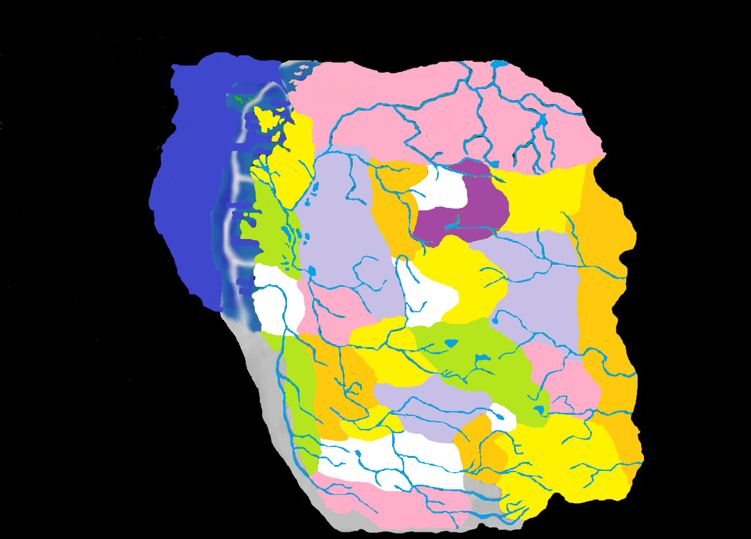
720 BC: Sithicus Takes Shape
Notes:
720 BC: Castle Ravenloft received another visitor soon after Strahd’s hibernation: Lord Soth. The Black Rose from Krynn had followed his traitorous seneschal into the Mists and found himself in Barovia. Soth pursued Caradoc in a violent path that led him through Gundarak where he slew Gundar’s son, Medraut. At last the Mists embraced him in a prison of his very own: Sithicus. The insular Sithican population did little to encourage trade, but the goods from Kartakass and Valachan could finally be reliably transported by river, and the quality and rarity of these commodities made Sithican tariffs worth the expense. Soth himself withdrew into Nedragaard Keep and was actually quite passive for the next several decades.

Slide 28
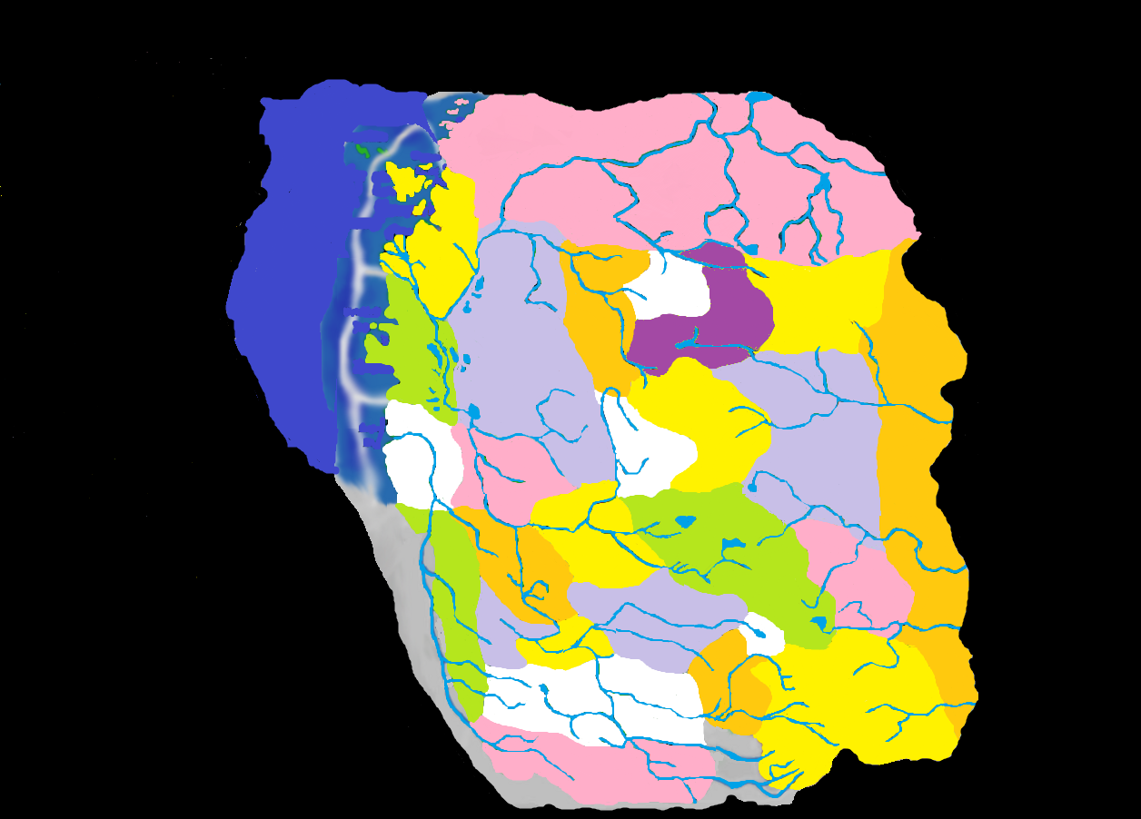
730 BC: Verbrek Takes Shape
Notes:
730 BC: Alfred Timothy, son of Darklord Nathan, became lord of the tiny sliver of wilderness known as Verbrek in 730 BC. It was a subtle change, as the portion of the land changed from a werewolf with one mindset to a werewolf with another. While some humans had been making their home in Arkendale for some time, Verbrek was not a place for humanity. Beasts ruled, and the uncaring hand of nature was jury. Alfred became her executioner. The Core braced itself in this time period, and aside from the death of Duke Gundar in 736 and the absorption of his domain by Barovia and Invidia, no further changes occurred until the Grand Conjunction in 740 BC.

Slide 29
THANKS
The Fraternity of Shadows, particularly David “Jester” Gibson, whose map was used as the basis for my work. Without that “stencil” I’d have never had the artistic talent to present this.
John W. Mangrum, whose Unofficial Ravenloft Timeline was invaluable in helping to keep dates straight.
Zak “Lord Cyclohexane” Gillman, whose alternate formation ideas will be presented in a separate PowerPoint
This concludes my own theory of the formation of the Demiplane of Dread. The absence of the actual land seemed to create the most continuity errors and this timeline attempts to remedy some of those in a logical fashion. Unlike the Canon version of this project, there are a number of assumptions on my part that are required to understand this timeline, particularly in the way Barovia and Mordent get broken up. If nothing else I hope this timeline sparks some lively discussion among the people to whom this setting is important.
Matt “Strahdsbuddy” Doyle, 2011
Insert Legal Disclaimer Here

